Slide 1
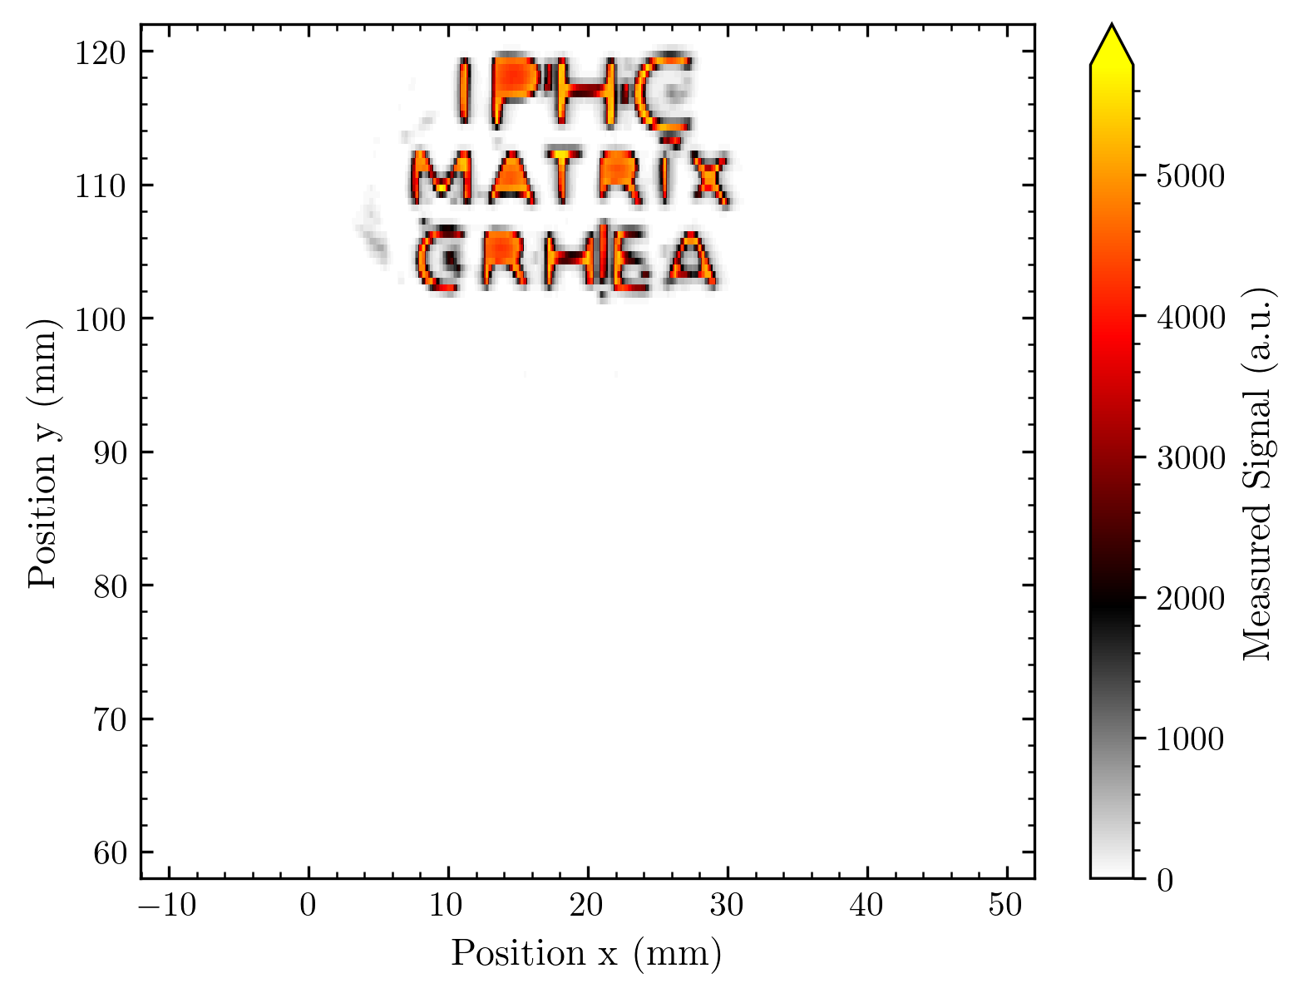






Results based on 1D and 2D arrays at IPHC Strasbourg
Nico Brosda, Stéphane Higueret 19.11.2024

Slide 2
Schedule (I‘ll leave room for discussion after each block)
Short Reminder: How we measure at Cyrcé
Reminder: First arrays measured at Cyrcé (partially shown at Lacassagne meeting)
Comparison: Difference between bonding fanout on GaN and direct bonding
Results: Voltage of AMS readout circuit + Linearity checks
Results: Homogeneity of array response
Some details of the image generation
Results: Imaging with different arrays
Results: Imaging in time dependence (creating movies of the beam)
Results: Signal in dependence of the proton energy
Results: Comparison with Gafchromic scans
Outlook: What results I haven‘t shown / What‘s to come

Slide 3
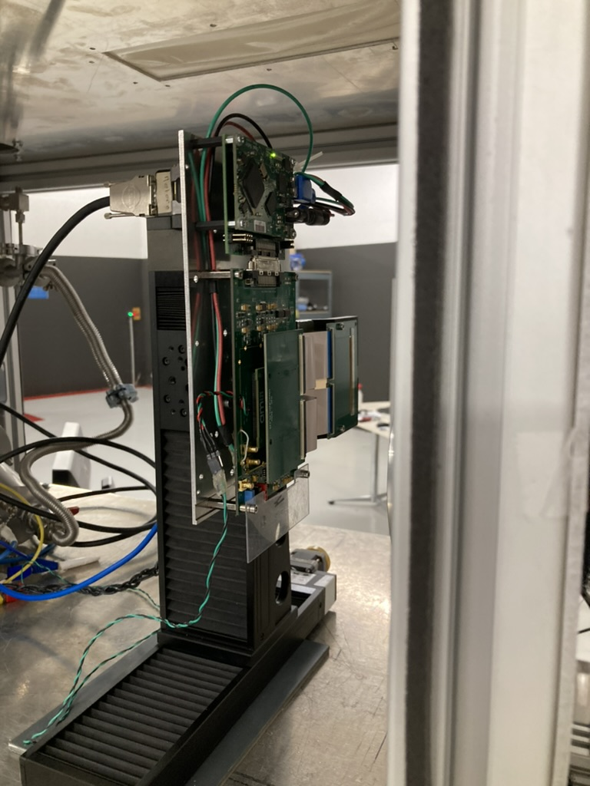
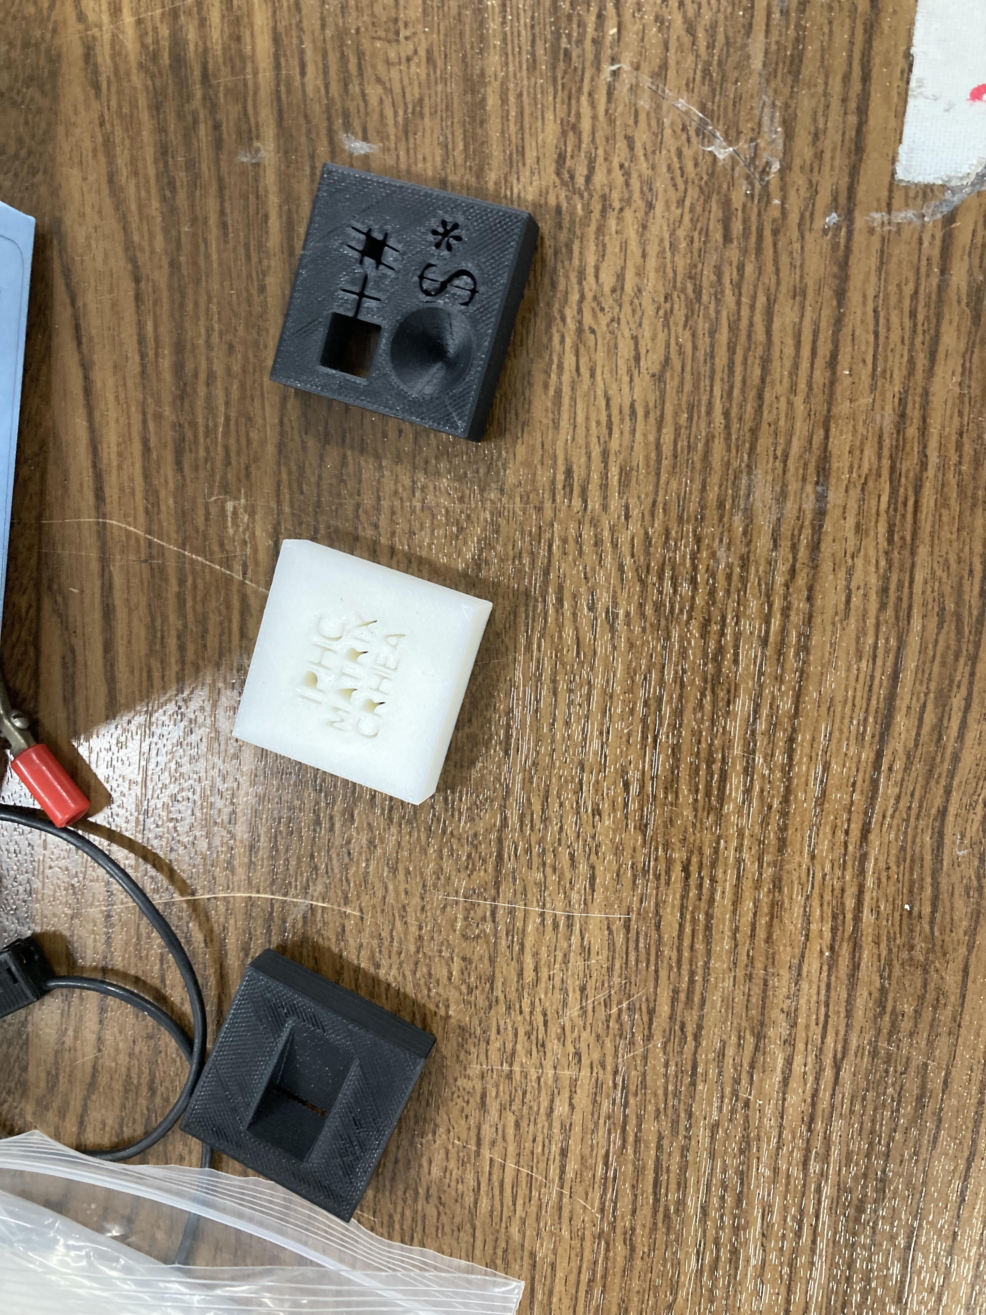
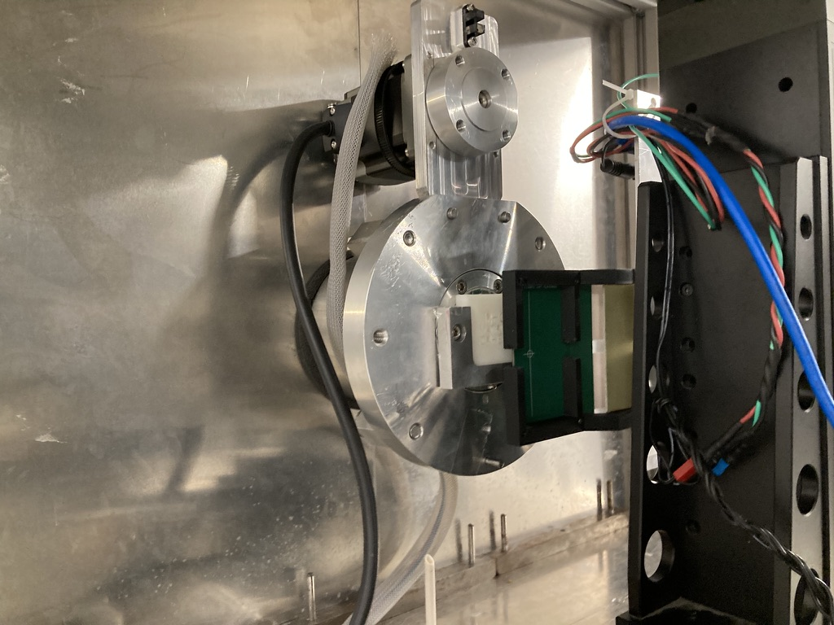
Reminder Setup at Cyrcé
Objects to image
Protons with ≈ 24 MeV
Usual current ≈ 2 nA
GaN arrays on XY-translation stage
Optional: Diffuser in proton beam line (homogenize beam)
Diodes read out by AMS Test Kit
We do not vary the beam any longer (as done at the first measurements with 1 s pulses)
We usually integrate for 3 s
Aftwerwards: Data processing and image generation (code written by me)

Slide 4
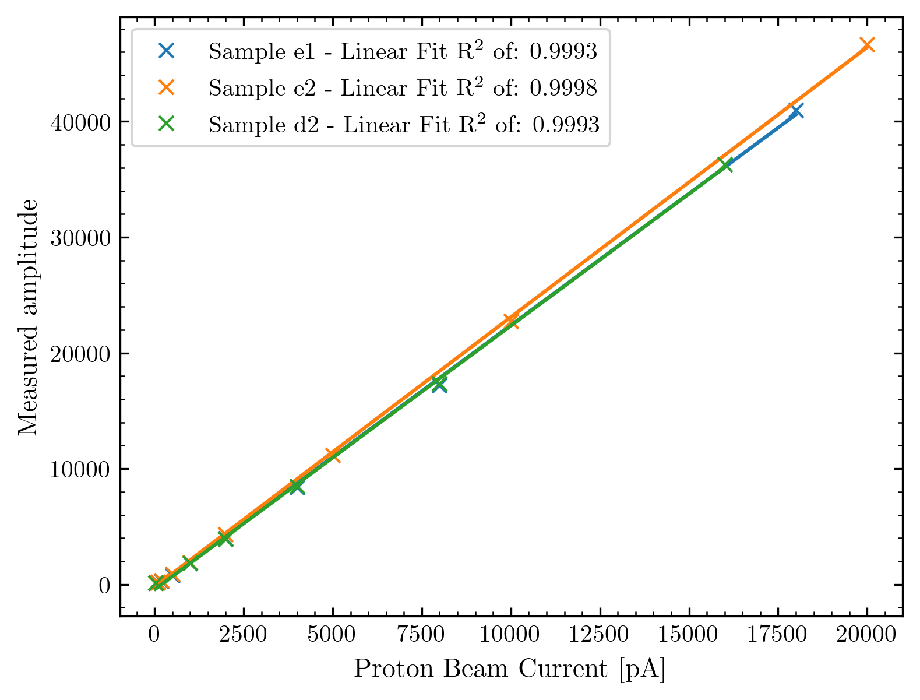
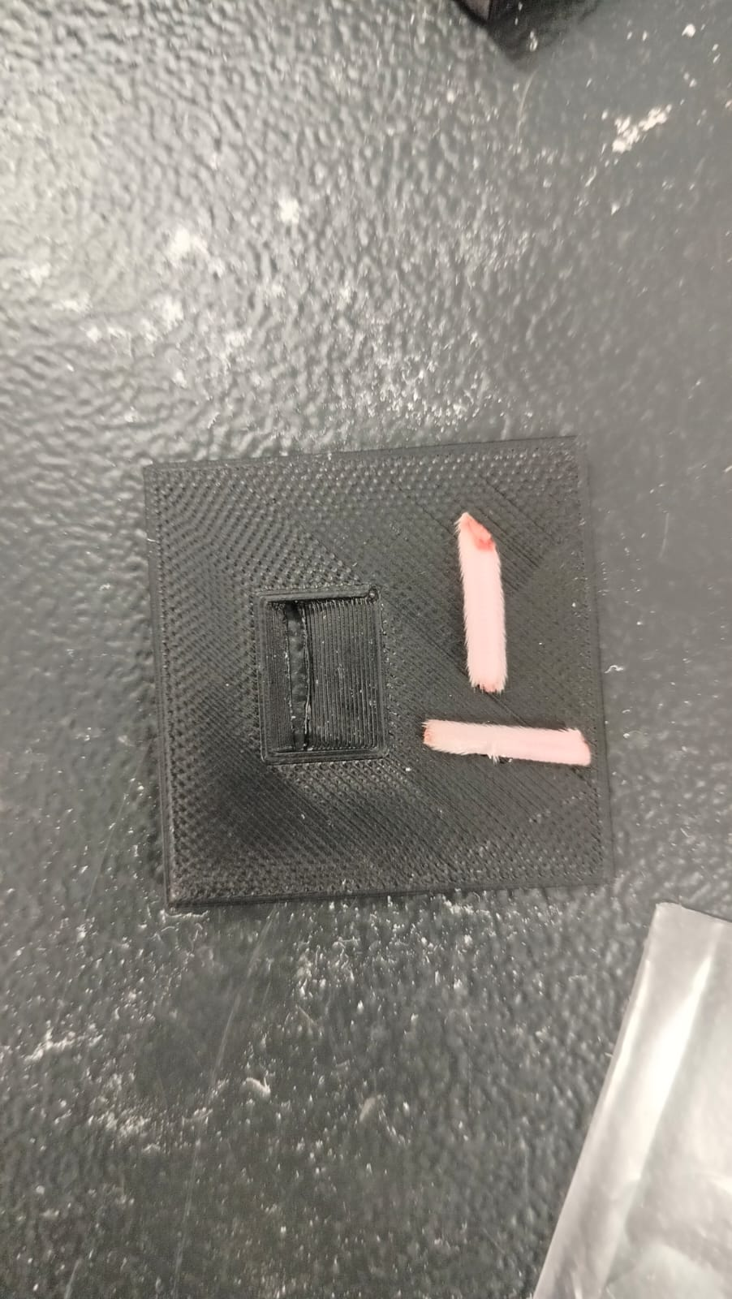
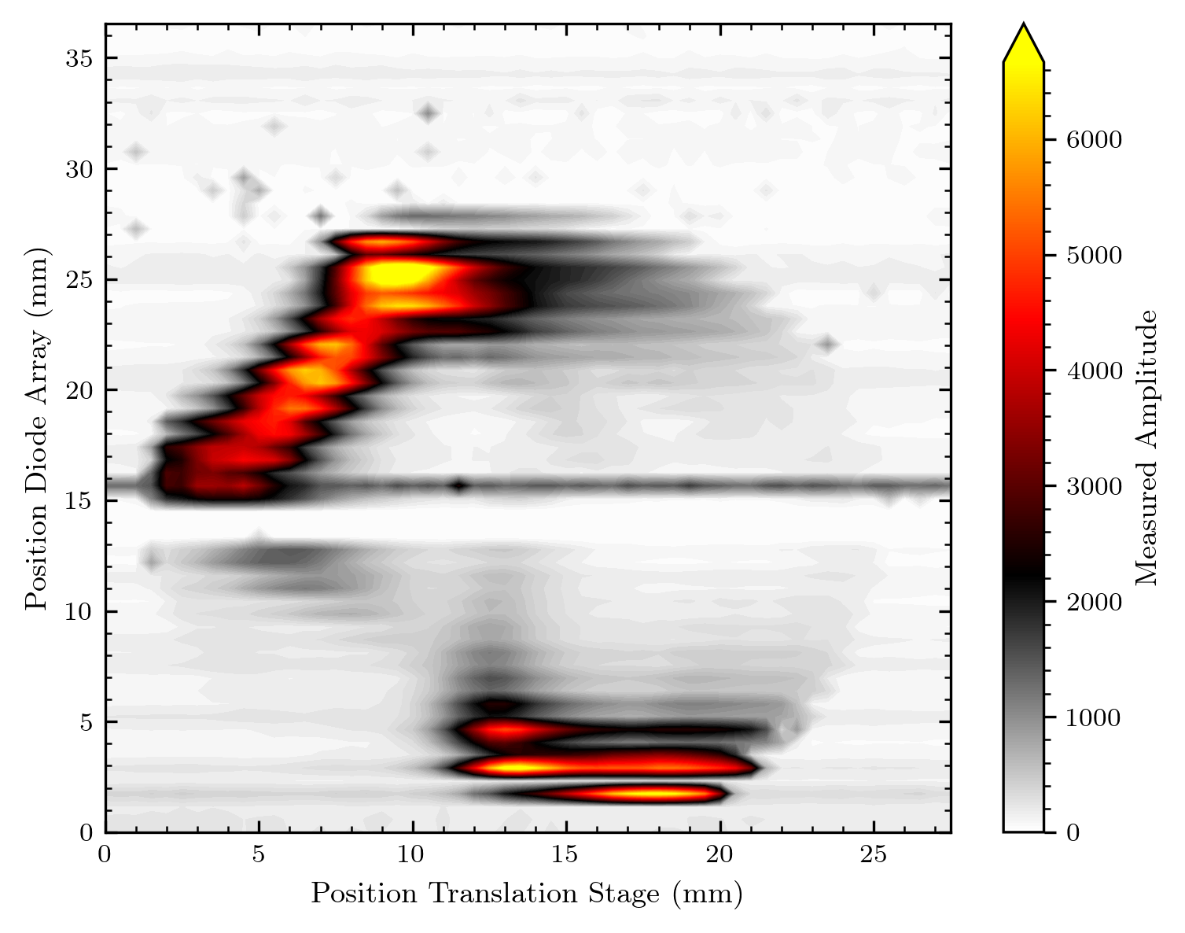
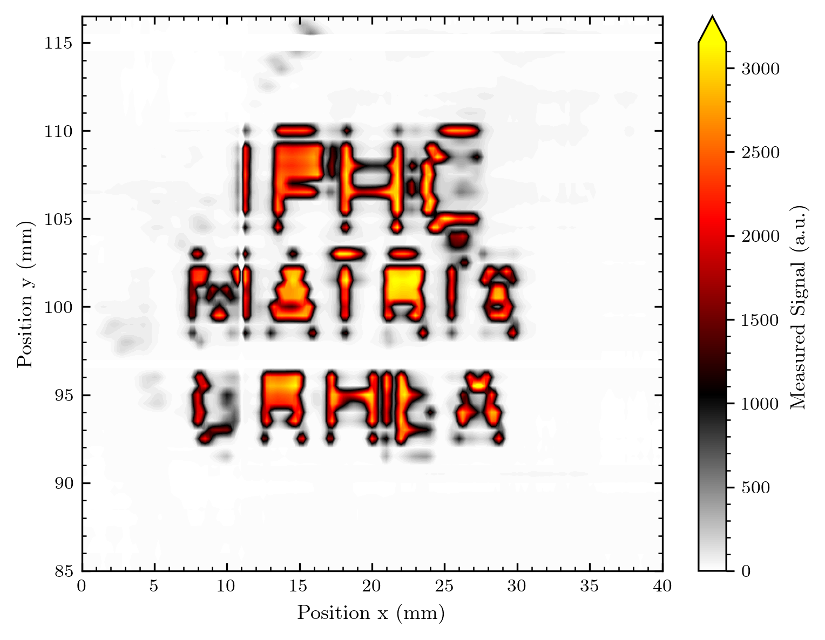
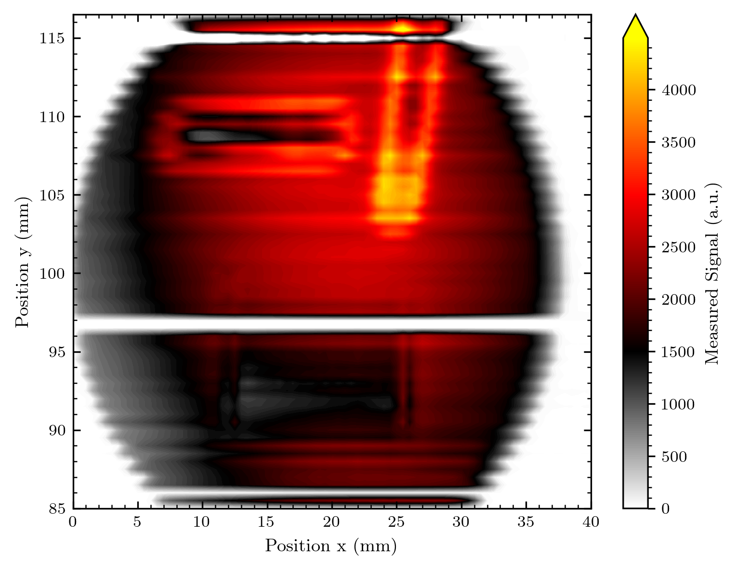
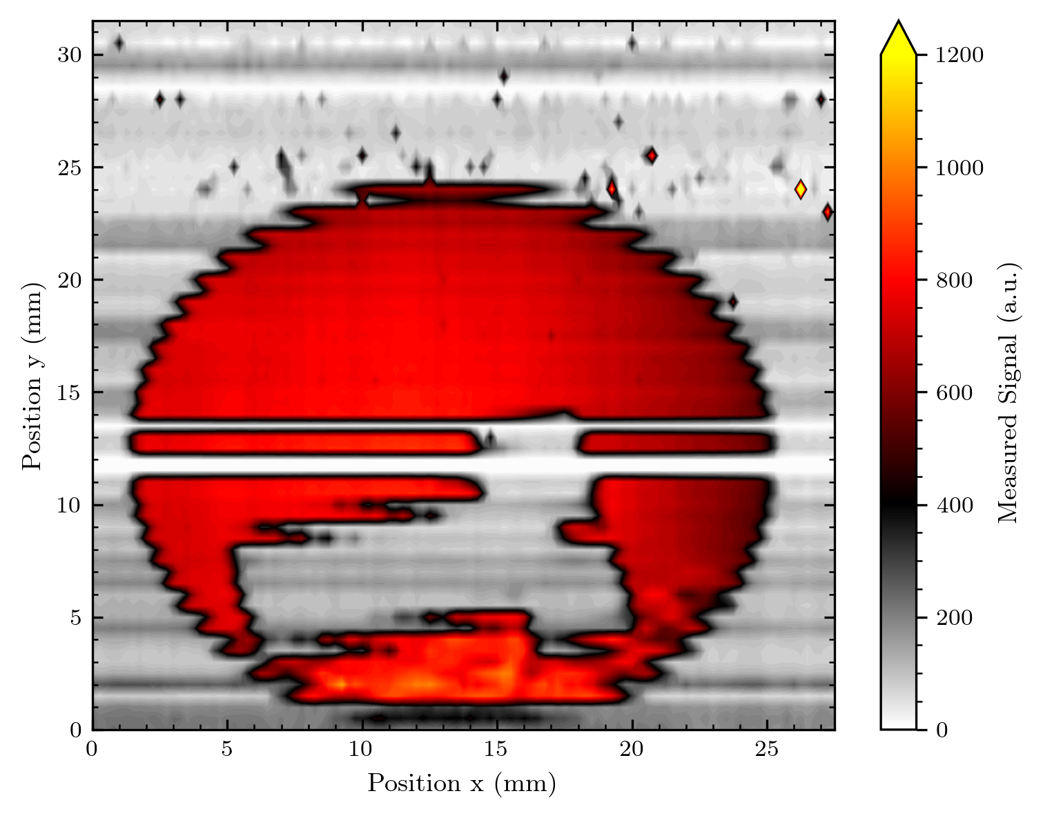
Results until June this year
We can resolve the
energy of protons
(and thus biological objects)
Excellent Linearity
Ability to image objects (or the undiffused beam)

Slide 5
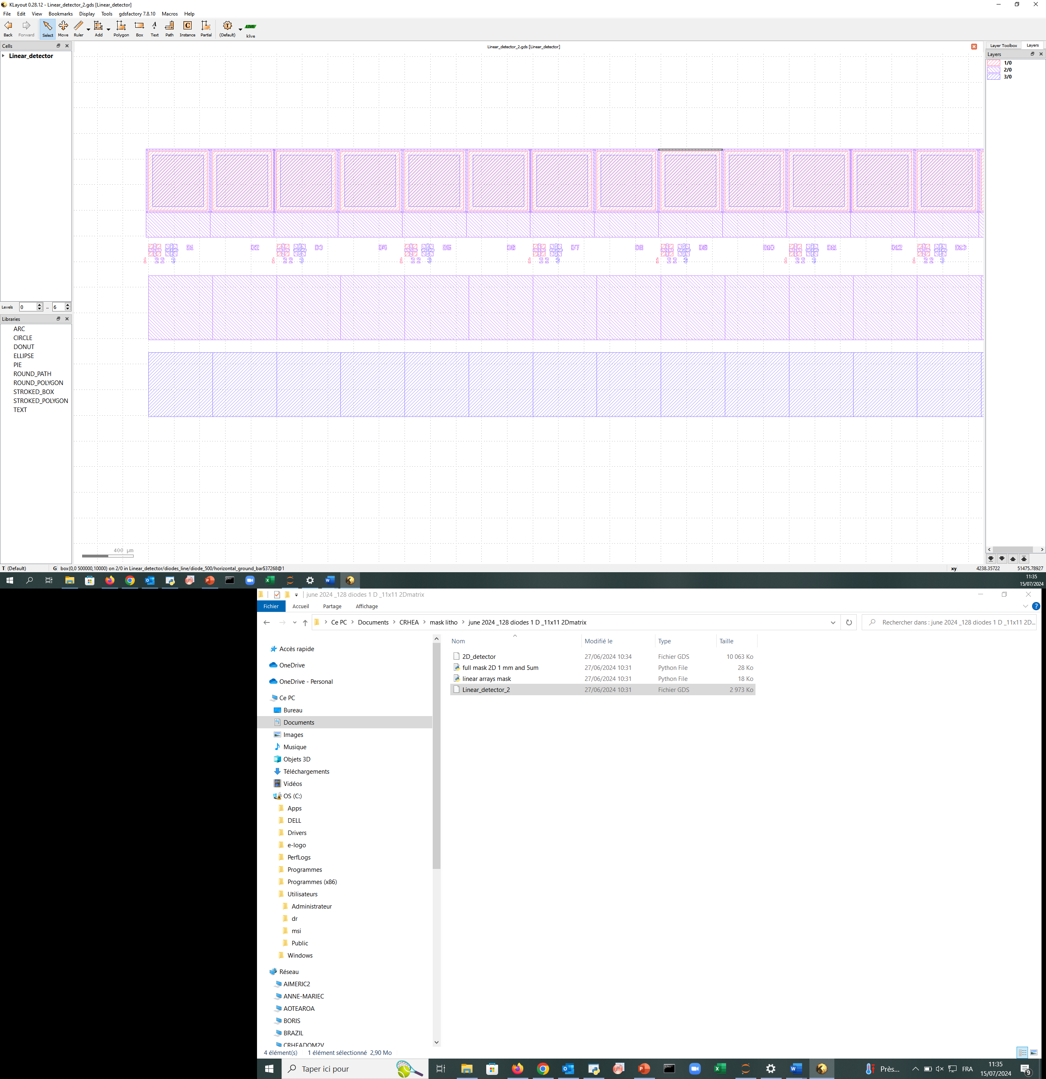
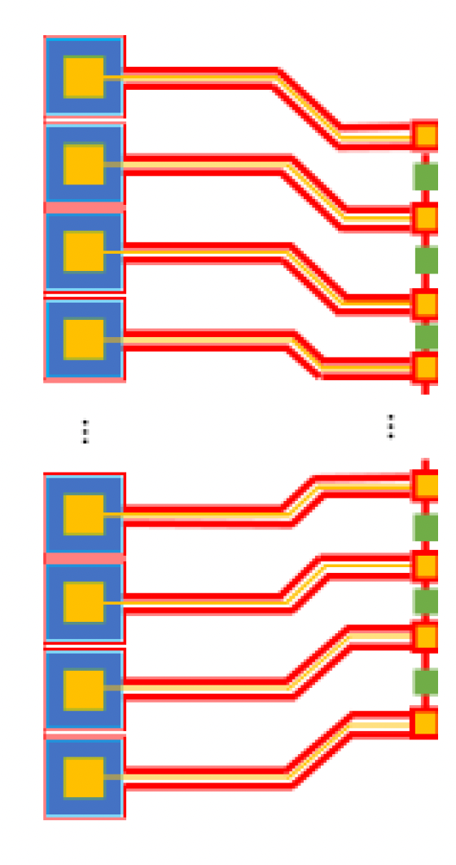
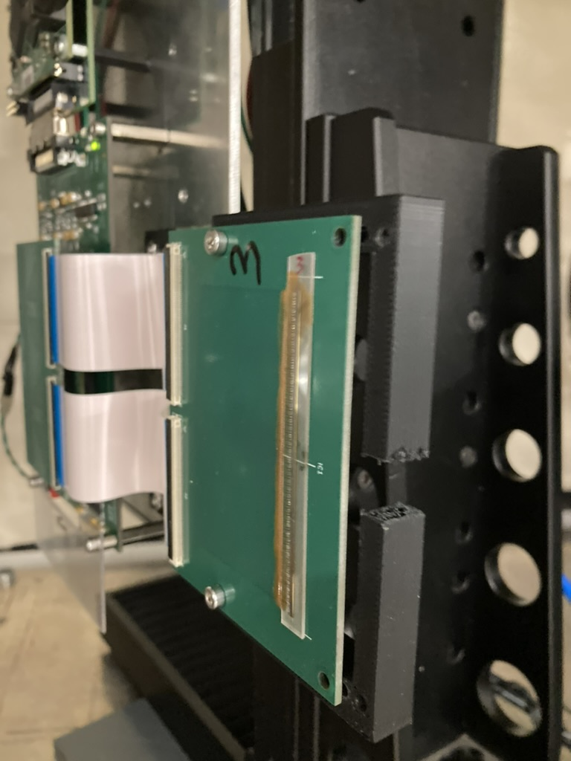
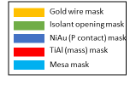
Difference in array design afterwards
SINGLE DIODE
Maximum total length 500µmx140=7cm
Previous 64 diode arrays
500µm
10µm
400µm
500µm
400µm
20µm
30µm
10µm
200µm
Direct bonding between
PCB card and diode
“Fan out” from diode contacts on the GaN wafer PCB card and diode
All measurements following are done with arrays without the ”fan out” = fewer fabrication steps + direct bonding!

Slide 6
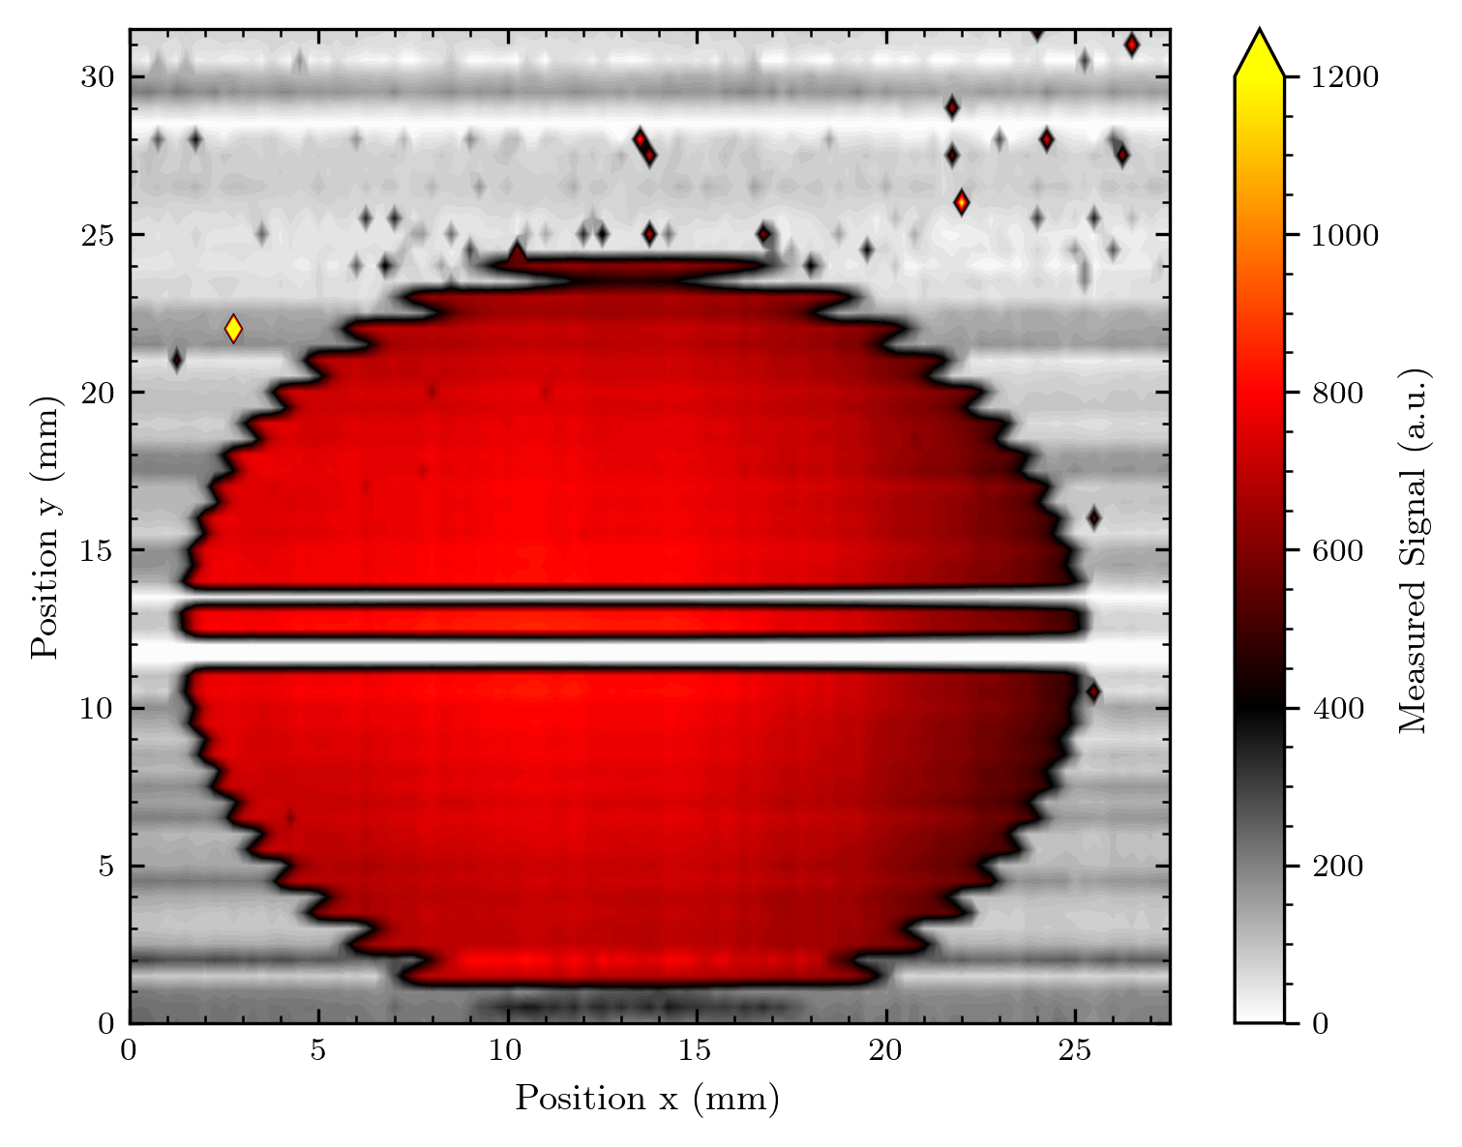
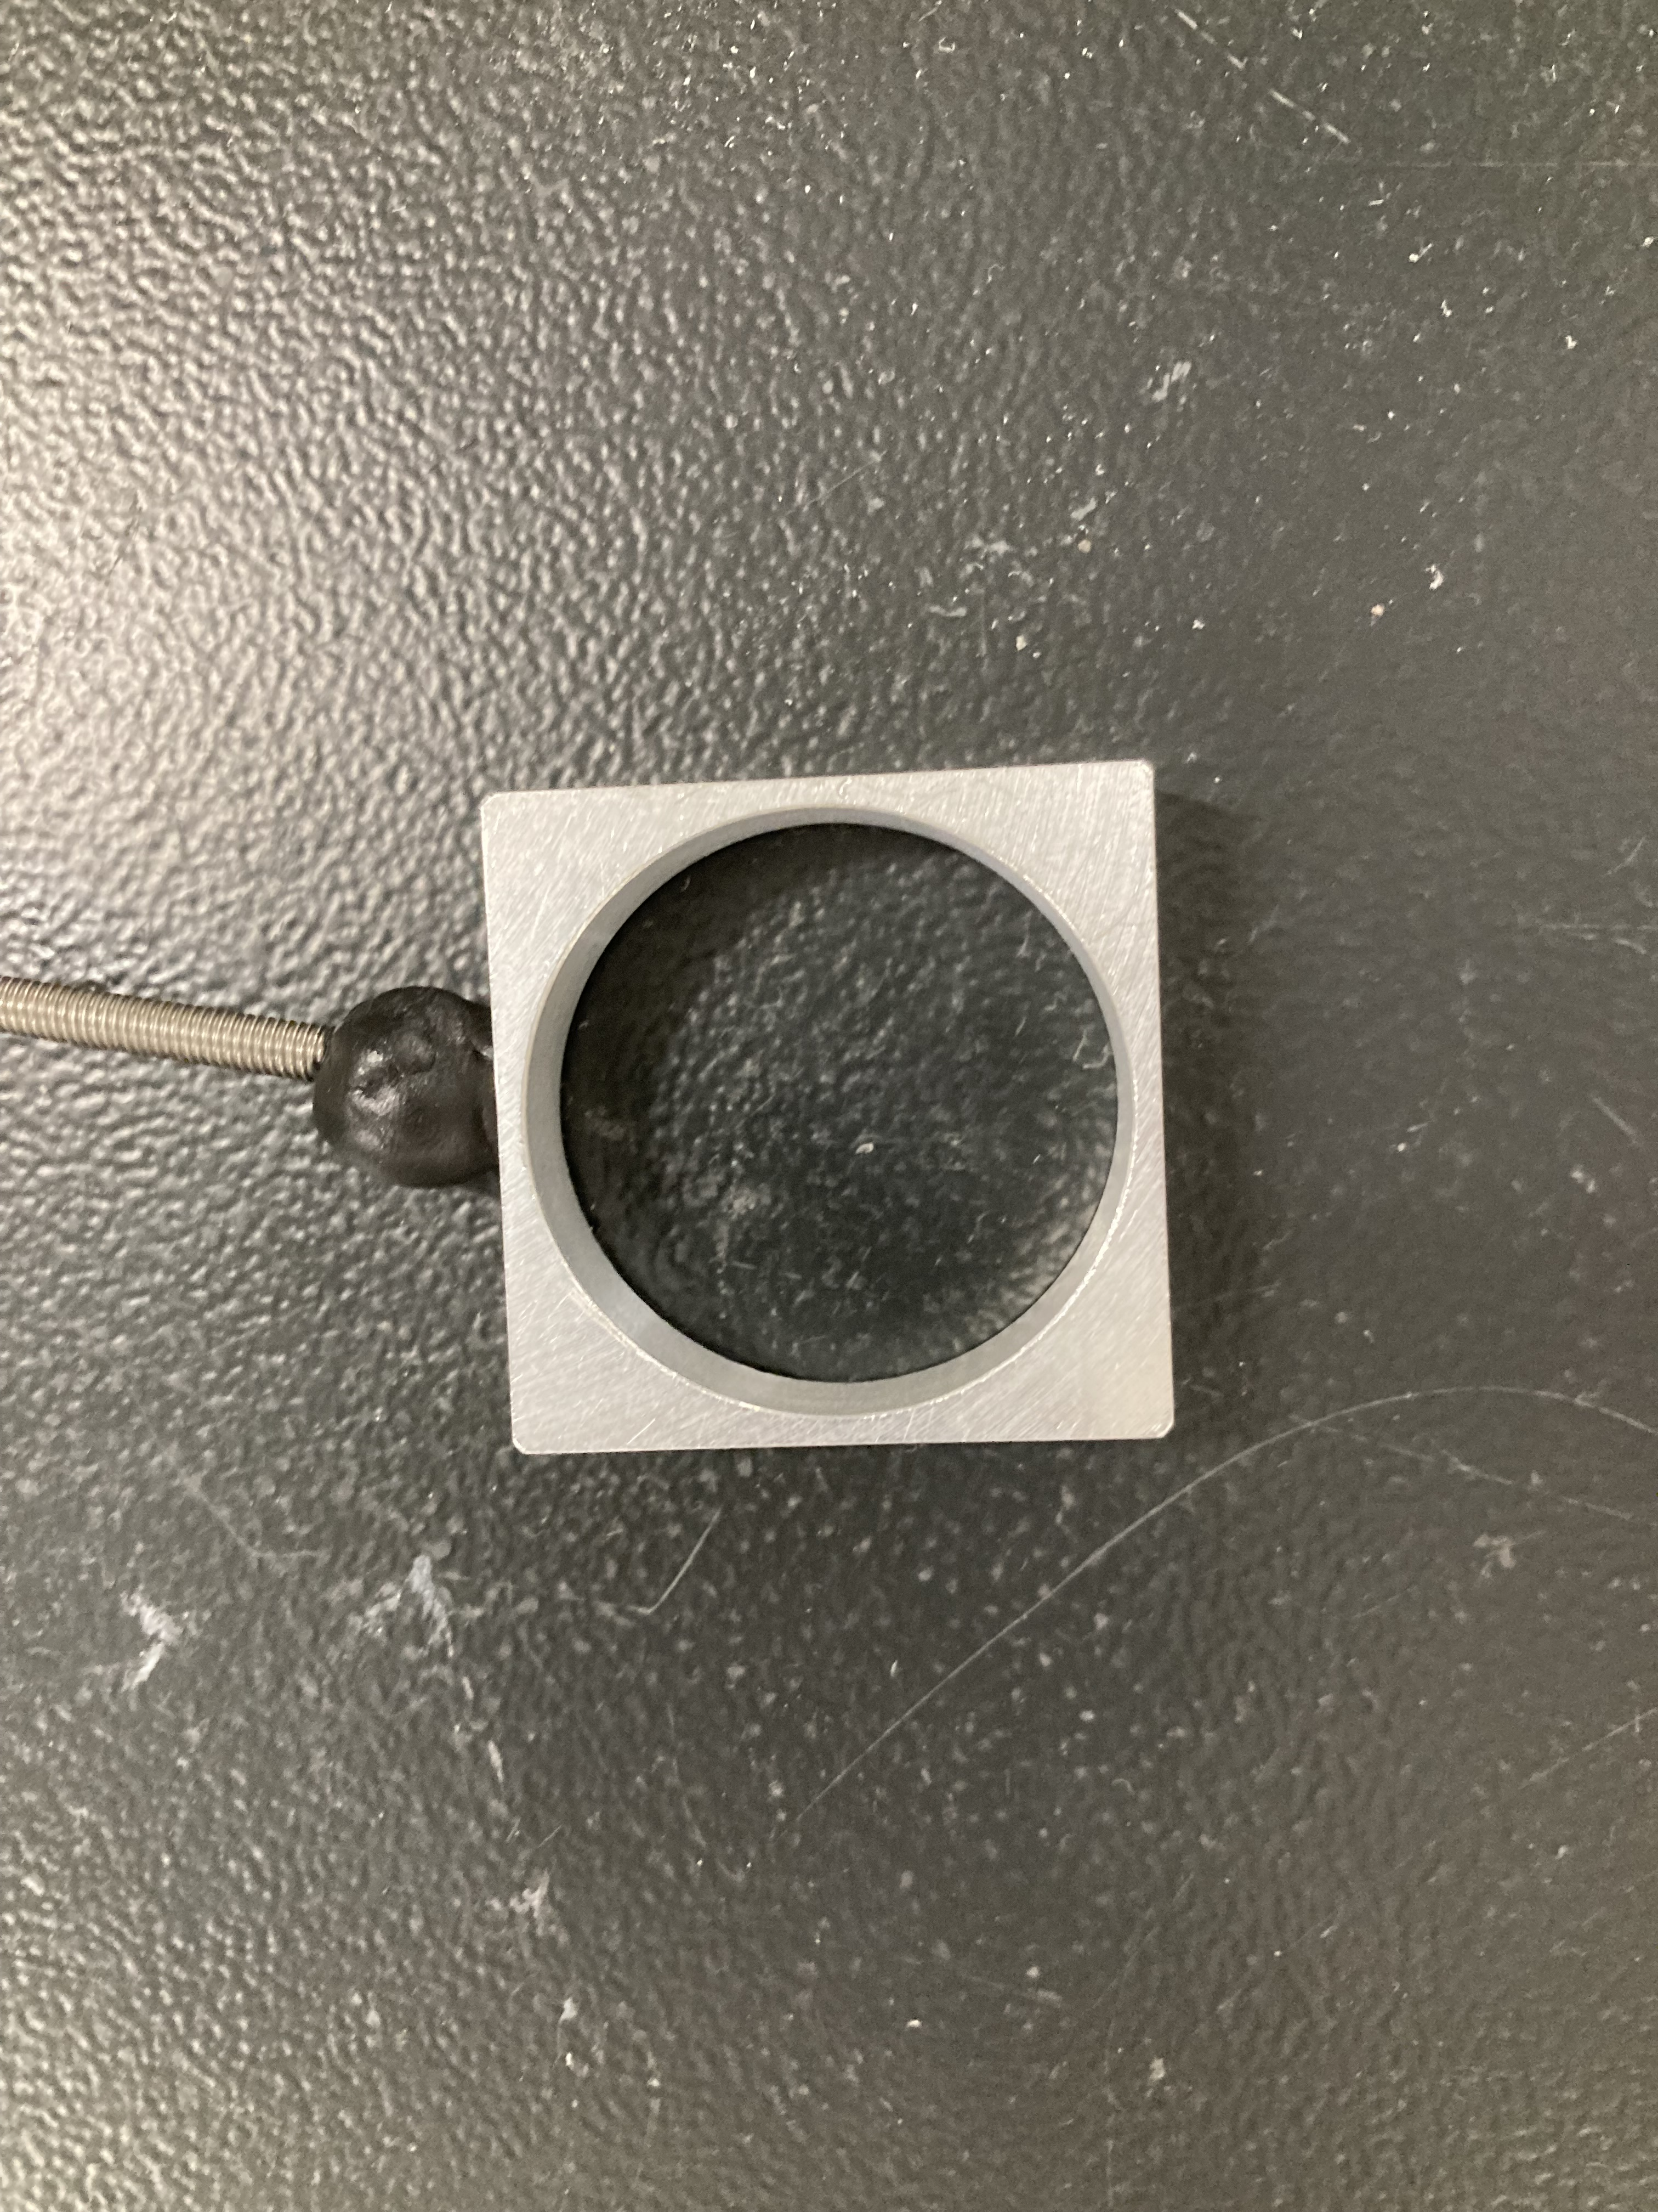
Comparison between array designs
“Old” 1x64 0.5x0.5 mm² array:
“New” 1x128 0.5x0.5 mm² diodes:

Slide 7
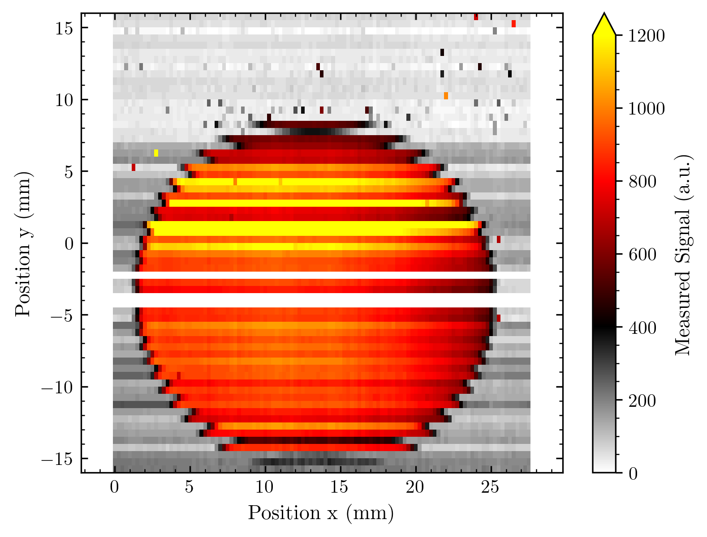
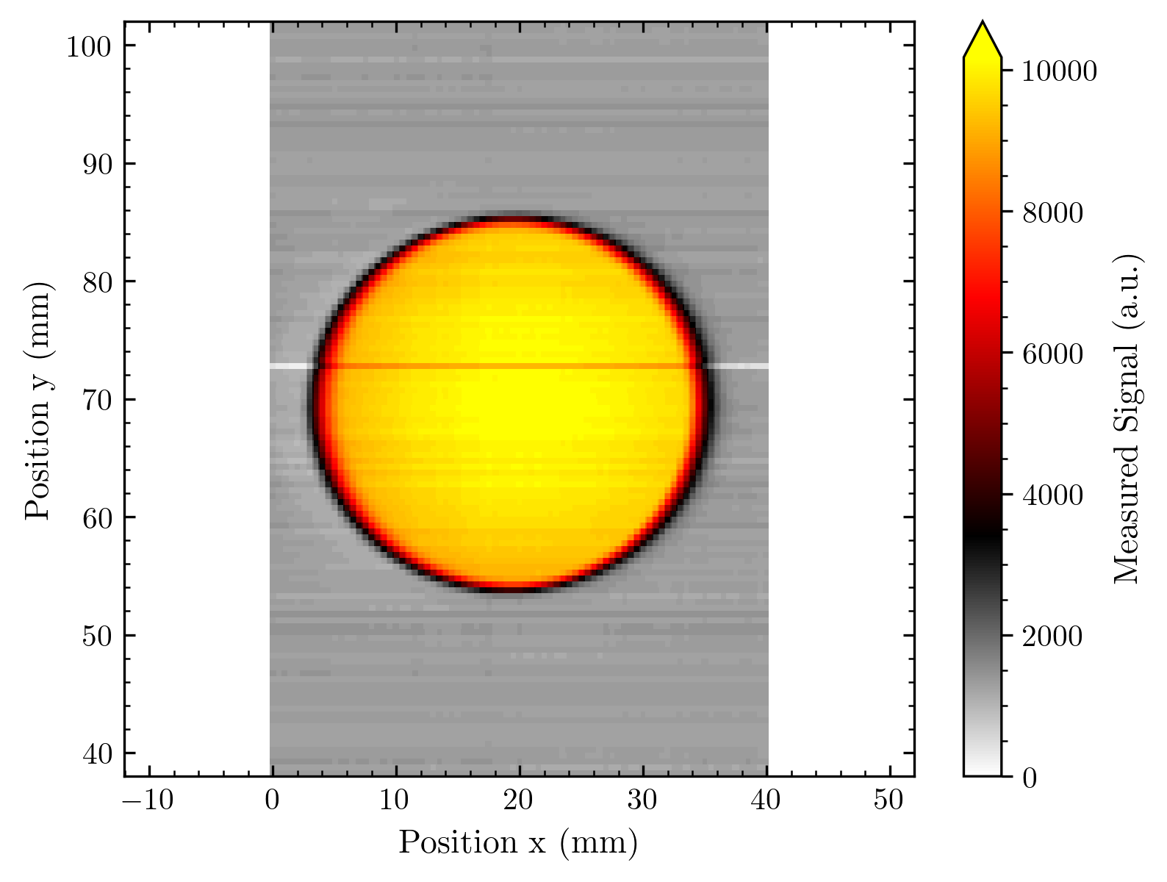
Let’s just compare the raw data
“Old” 1x64 0.5x0.5 mm² array:
“New” 1x128 0.5x0.5 mm² diodes:

Slide 8
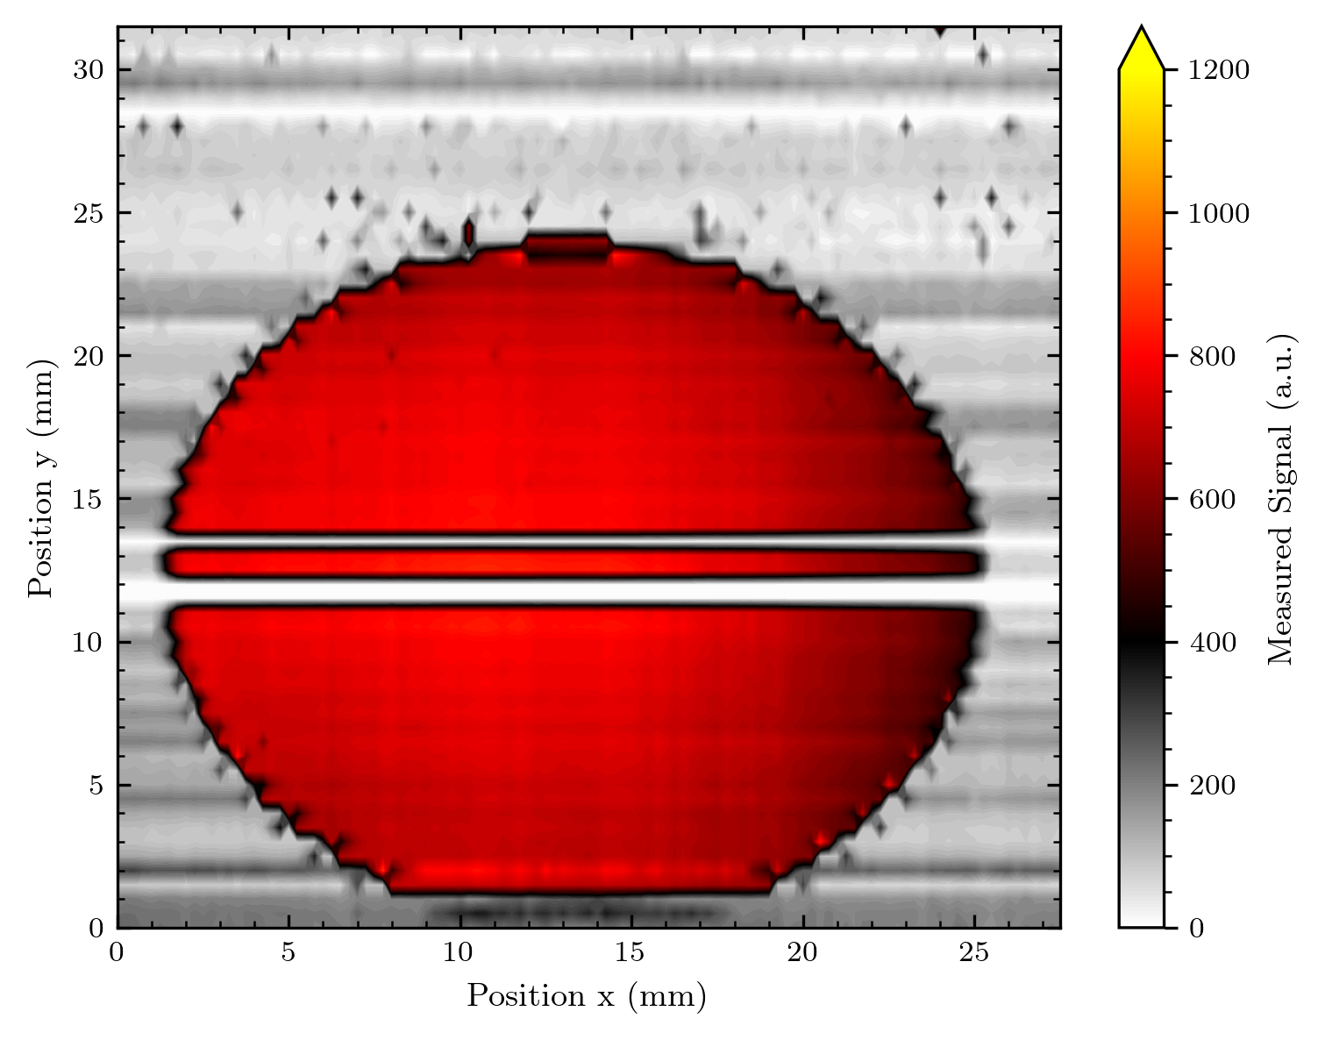
Why the difference?
Better quality (fewer fabrication steps)
Impact of metal ”fan out” on GaN wafer
We observe a transfer of irradiation-induced electrons between lines of “fan out”!
(We also modelled and partially corrected for this)
Before
After correction
Due to the new design, we do not have this problem any longer

Slide 9
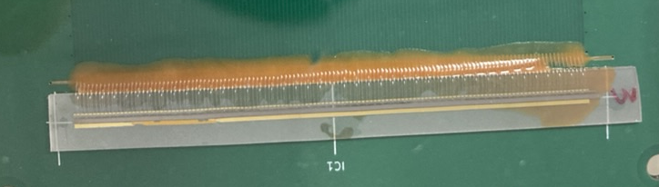
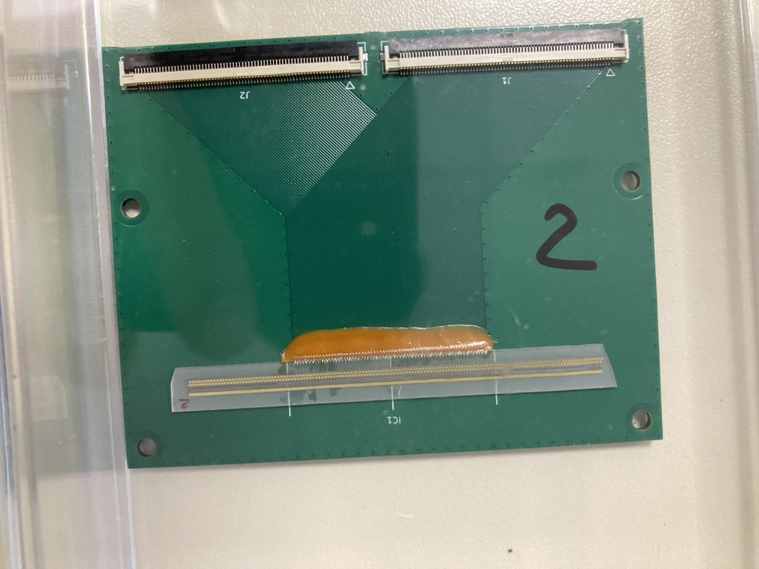
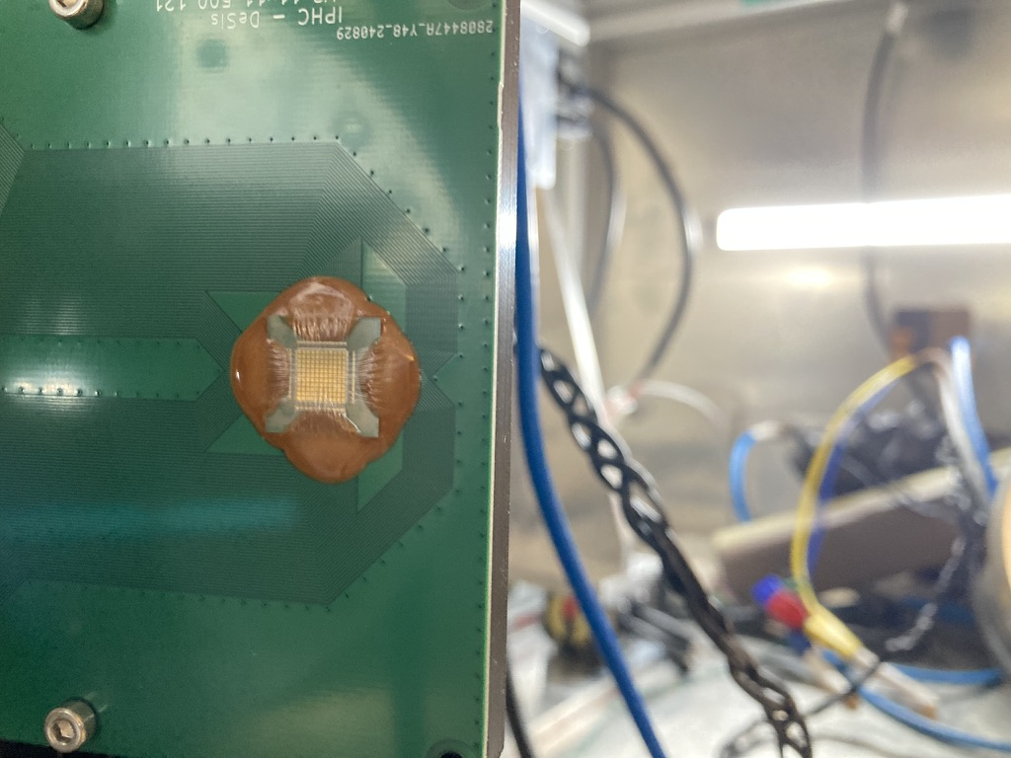
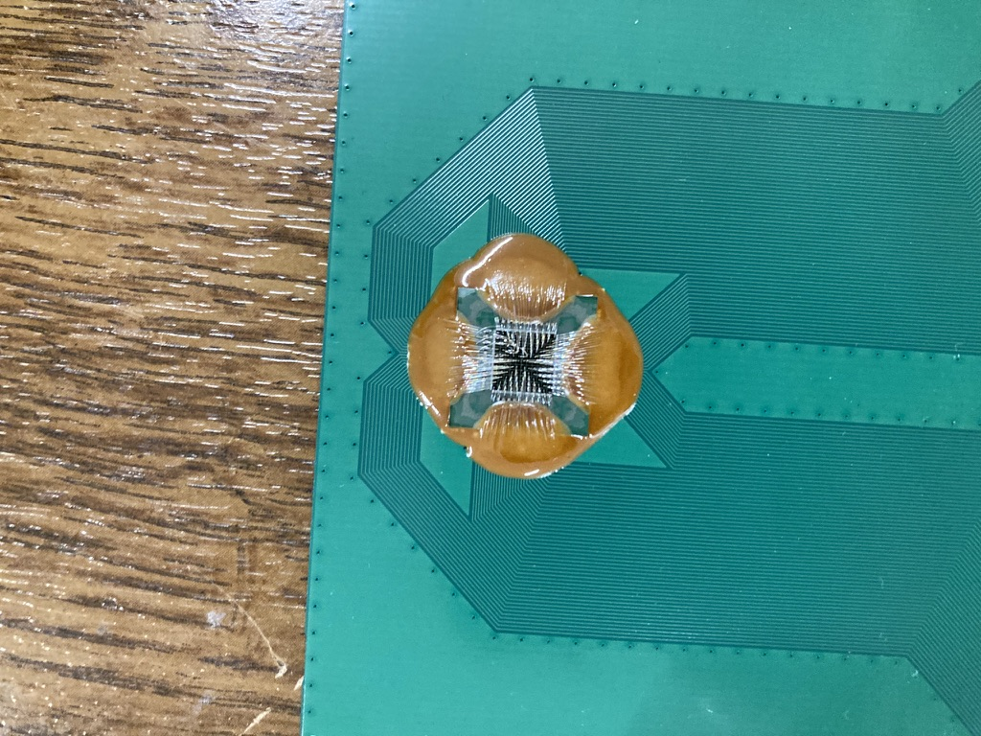
Overview of arrays measured so far
With “fan out”:
3 different 1x64 0.5x0.5 mm² line arrays
Without ”fan out”:
1x128 0.5x0.5 mm² line array
1x128 0.5x0.25 mm² line array
2x64 0.5x0.5 mm² line array (0.25 mm shifted)
2 different 11x11 1x1 mm² matrix arrays
11x11 0.5x0.5 mm² matrix arrays

Slide 10
Reminder: Sample structure
Active region

Slide 11
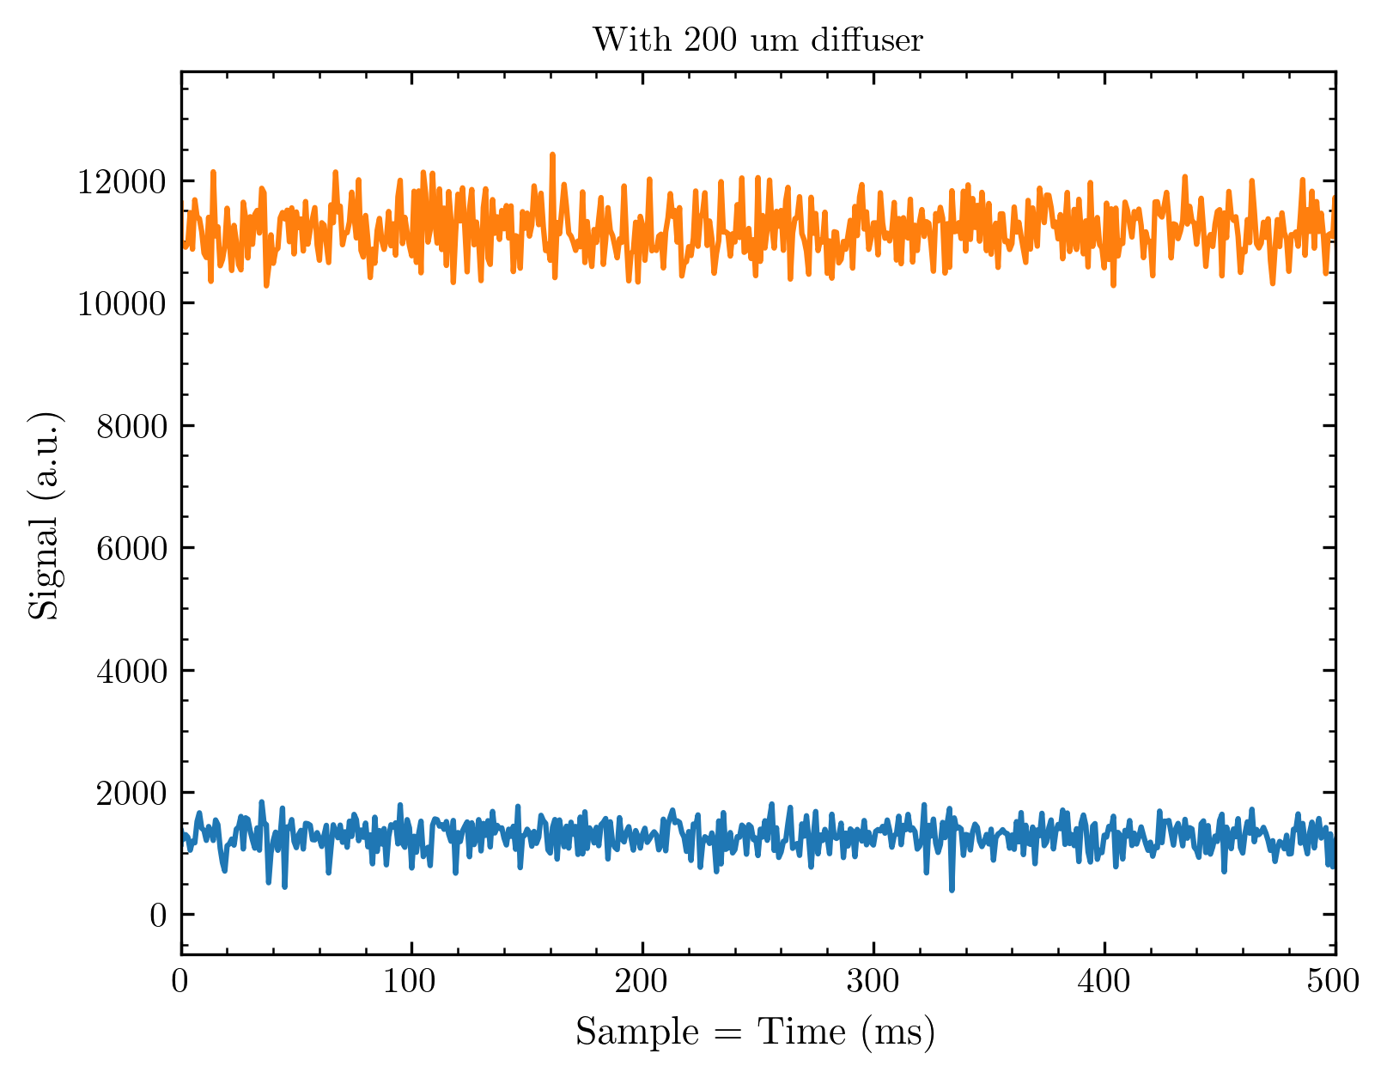
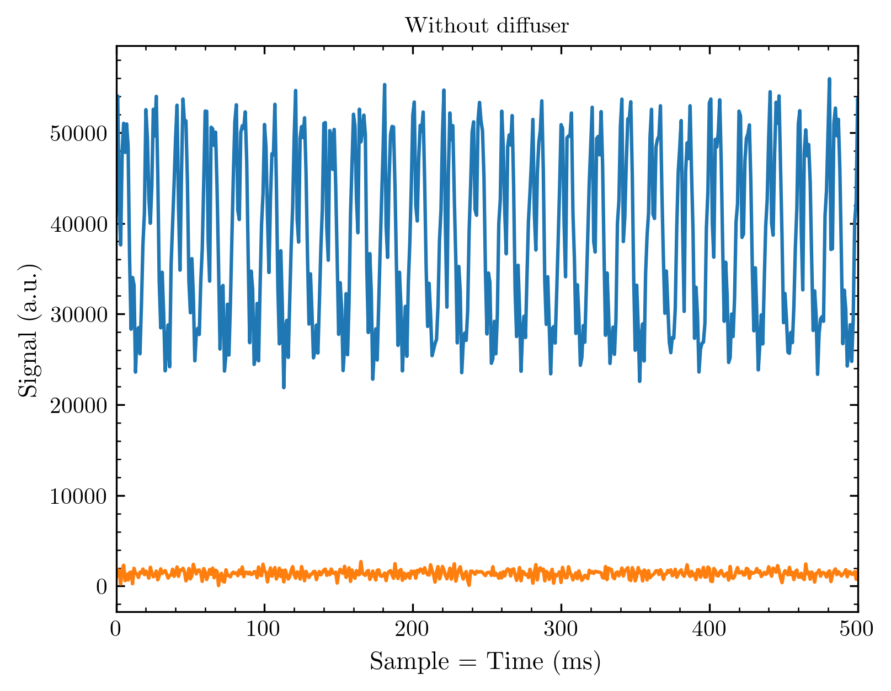
50 Hz noise on undiffused beam?!
Compared is the highest and lowest (dark) signal of arbitrary measurements with and without diffuser
I observed this modulation for different measurement days whenever we measured without diffuser; I will nevertheless bring these observations in plots for you to compare
If you count the periods on the right side you find: 10 periods in 200 ms meaning 50 in 1s = 50 Hz…

Slide 12
Part II
Voltage tests
Linearity checks
Homogeneity of array response

Slide 13
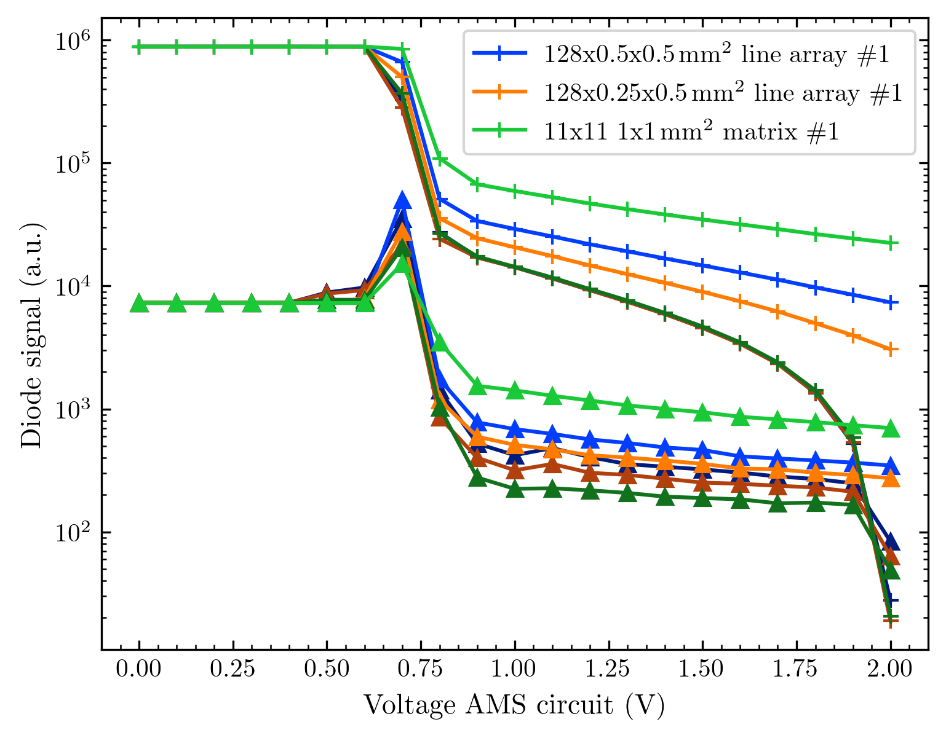
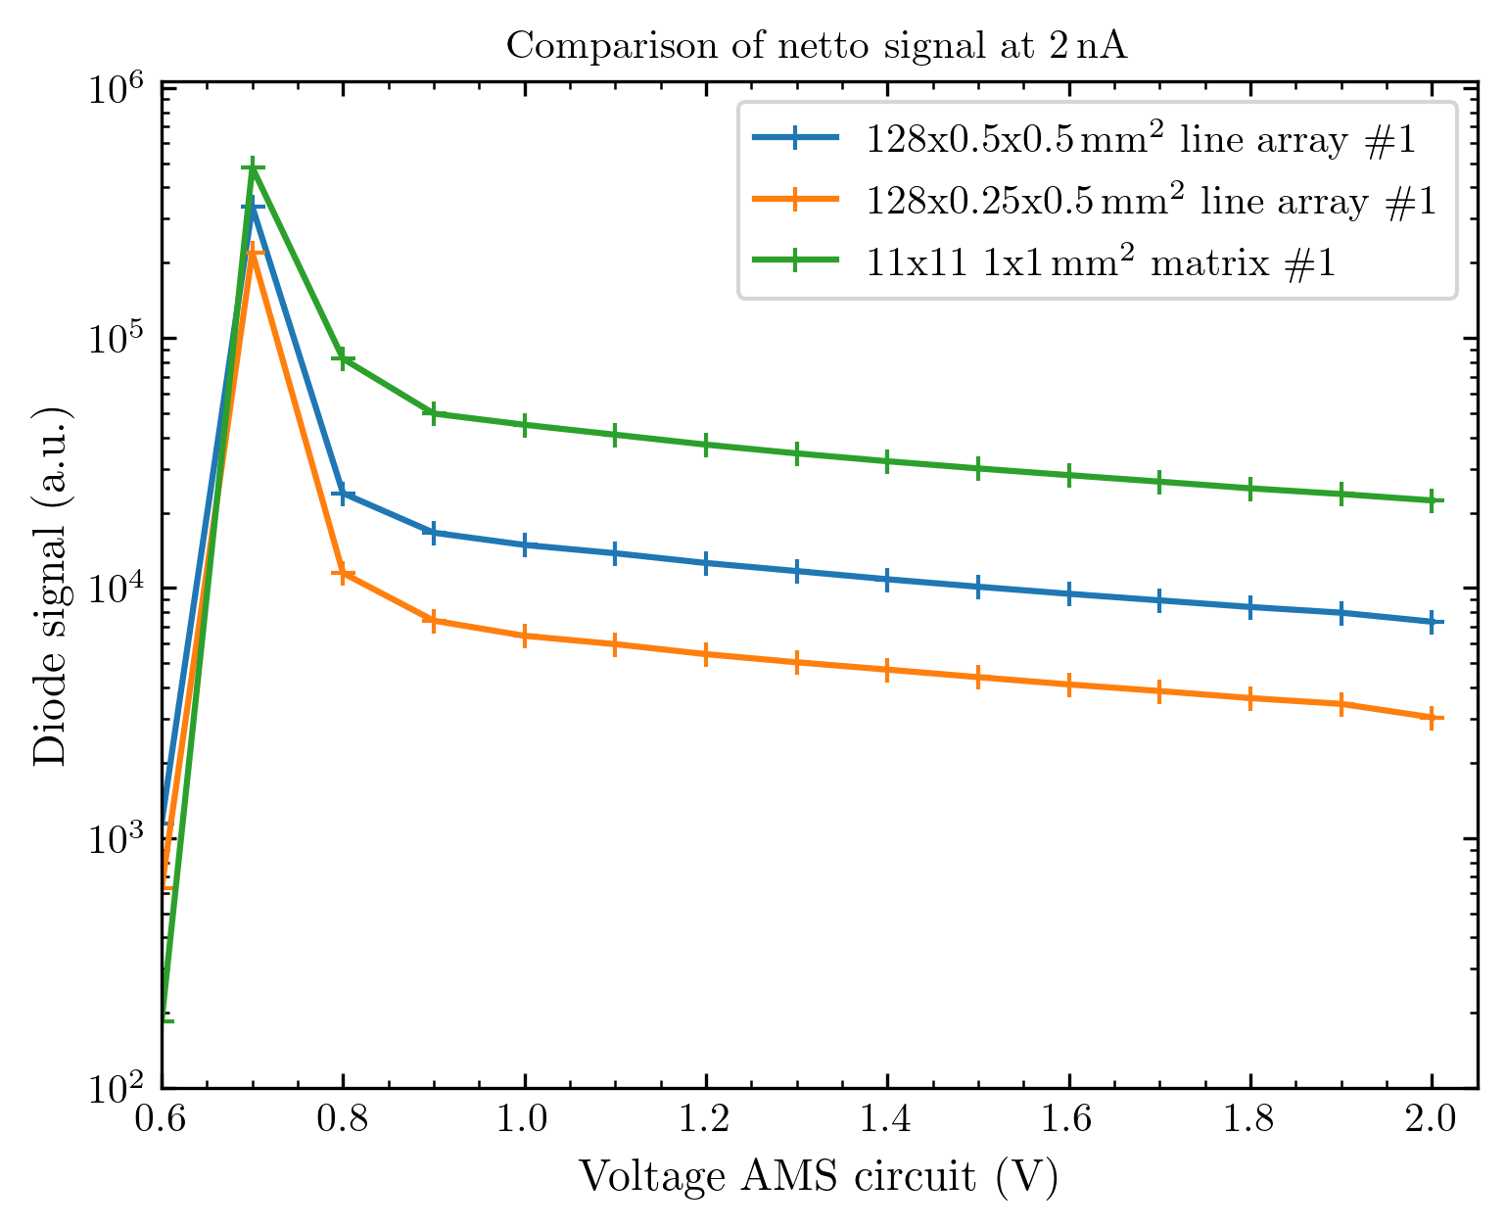
Voltage tests

Slide 14
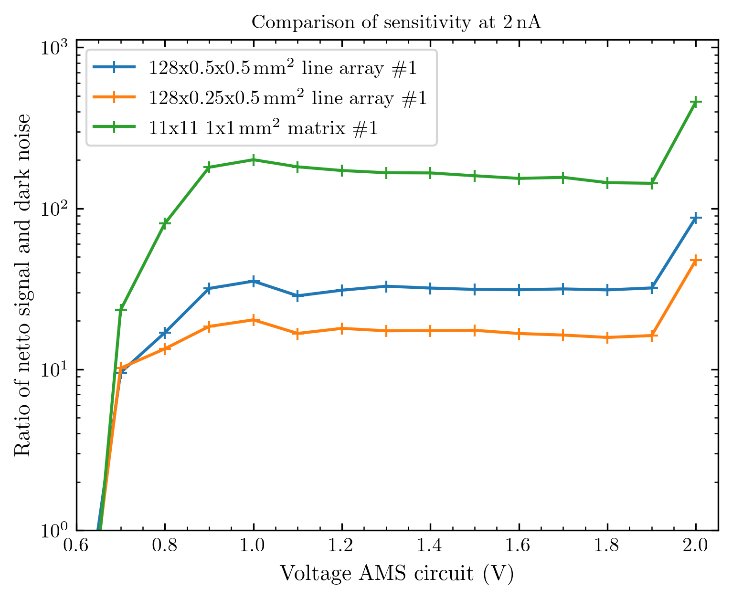
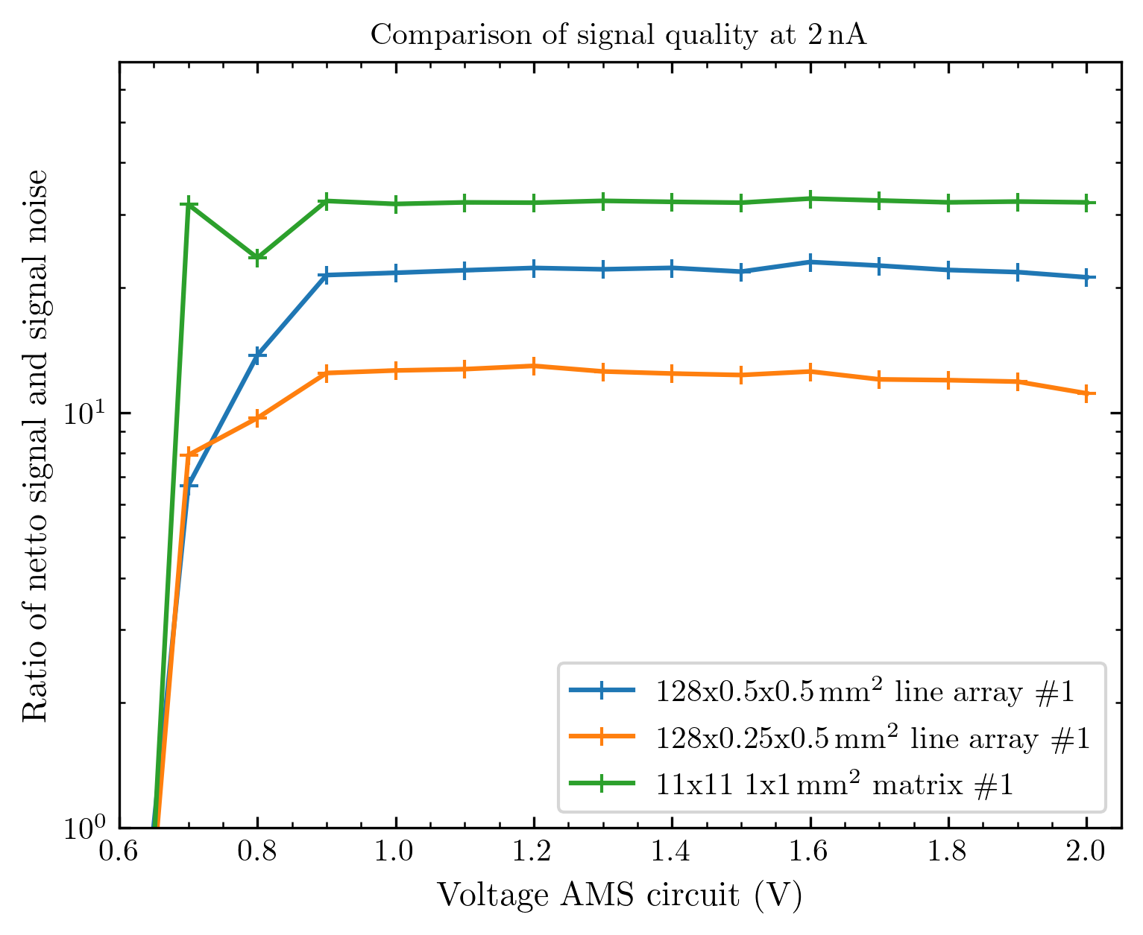
Sensitivity and signal quality

Slide 15
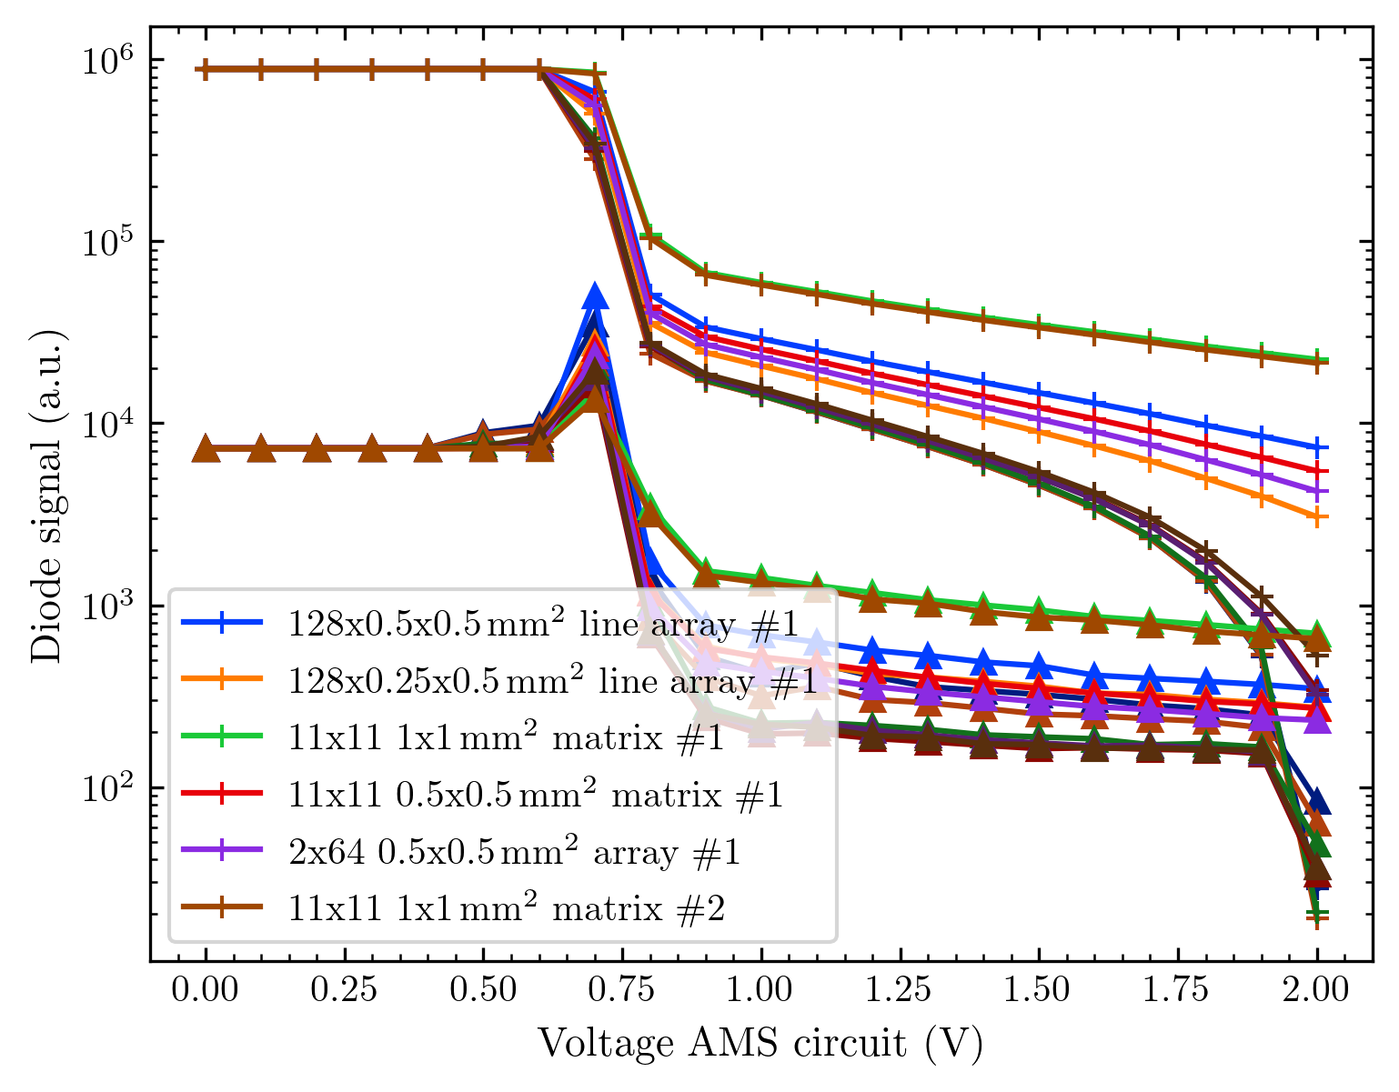
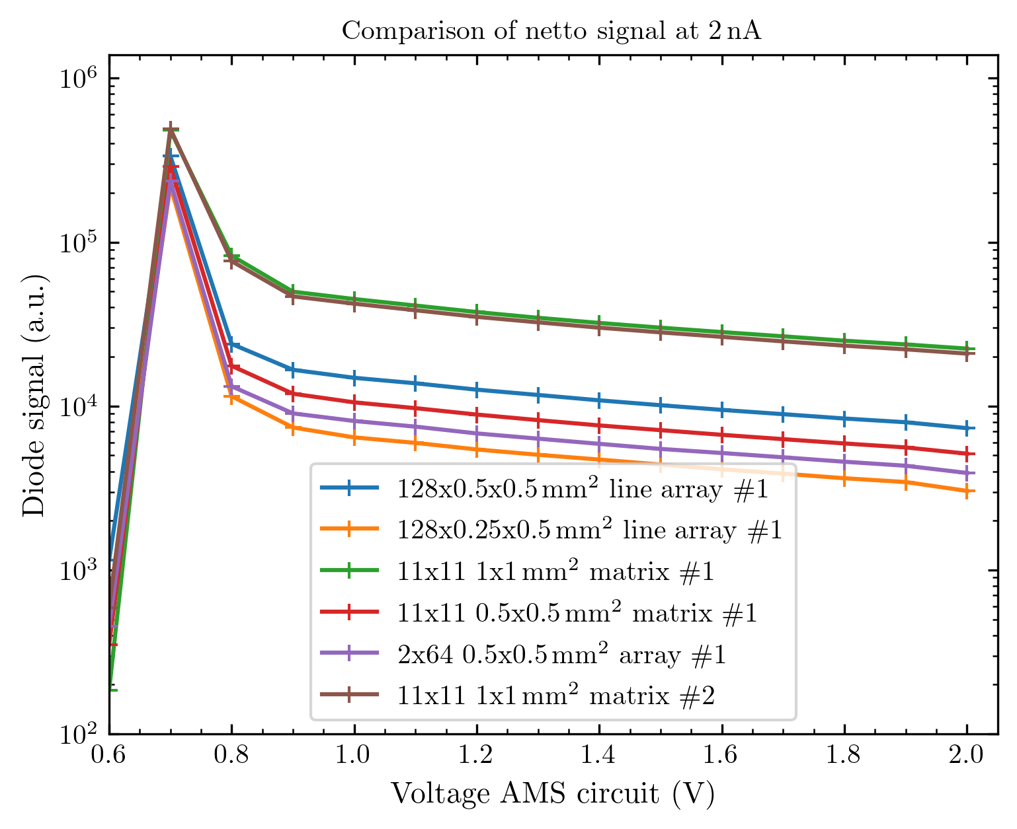
All voltage scans up to the 22nd of October

Slide 16
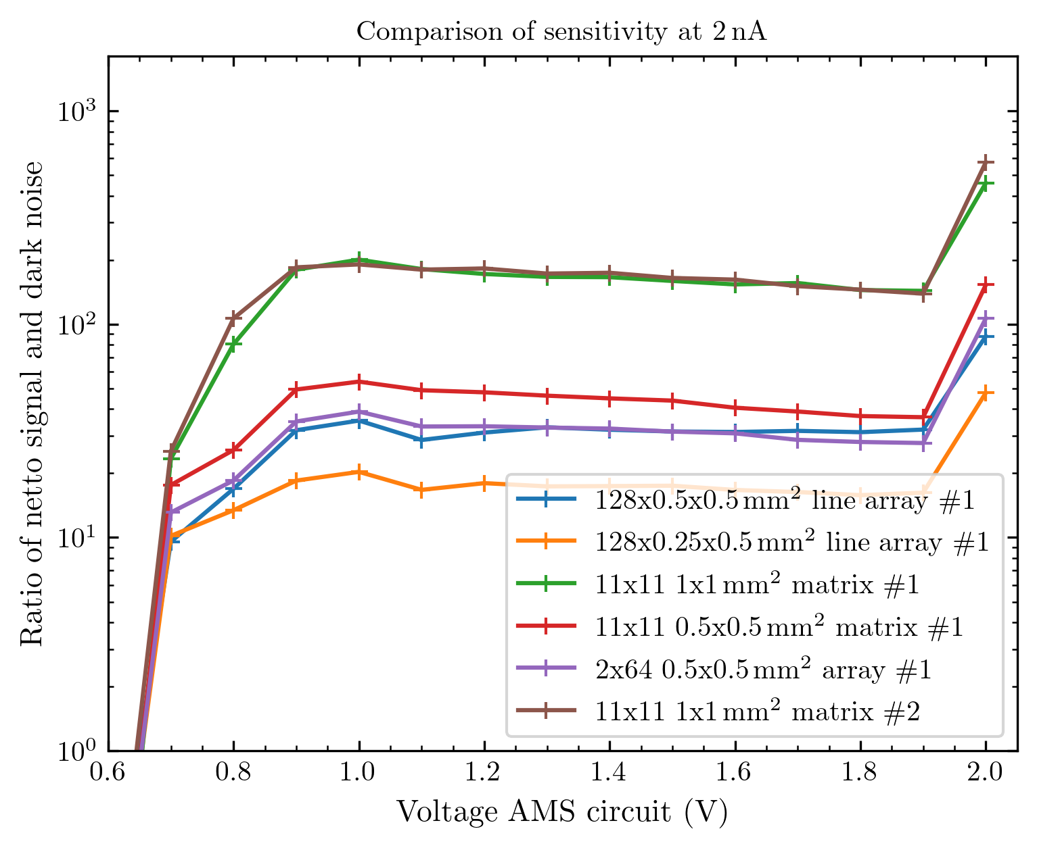
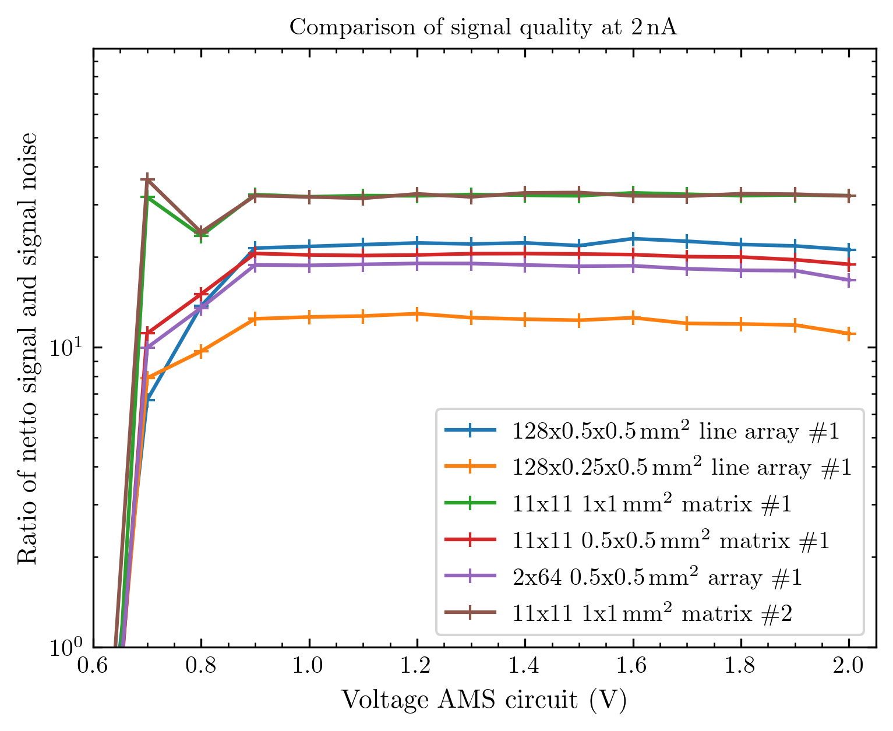
Sensitivity and signal quality
Note that the sensitivity implies that we could e.g. detect a current ~ 200 lower than we had for the big matrix arrays)
Meaning: 2 nA at Faraday cup / 200 = 10 pA at Faraday cup under these conditions for the large diodes.

Slide 17
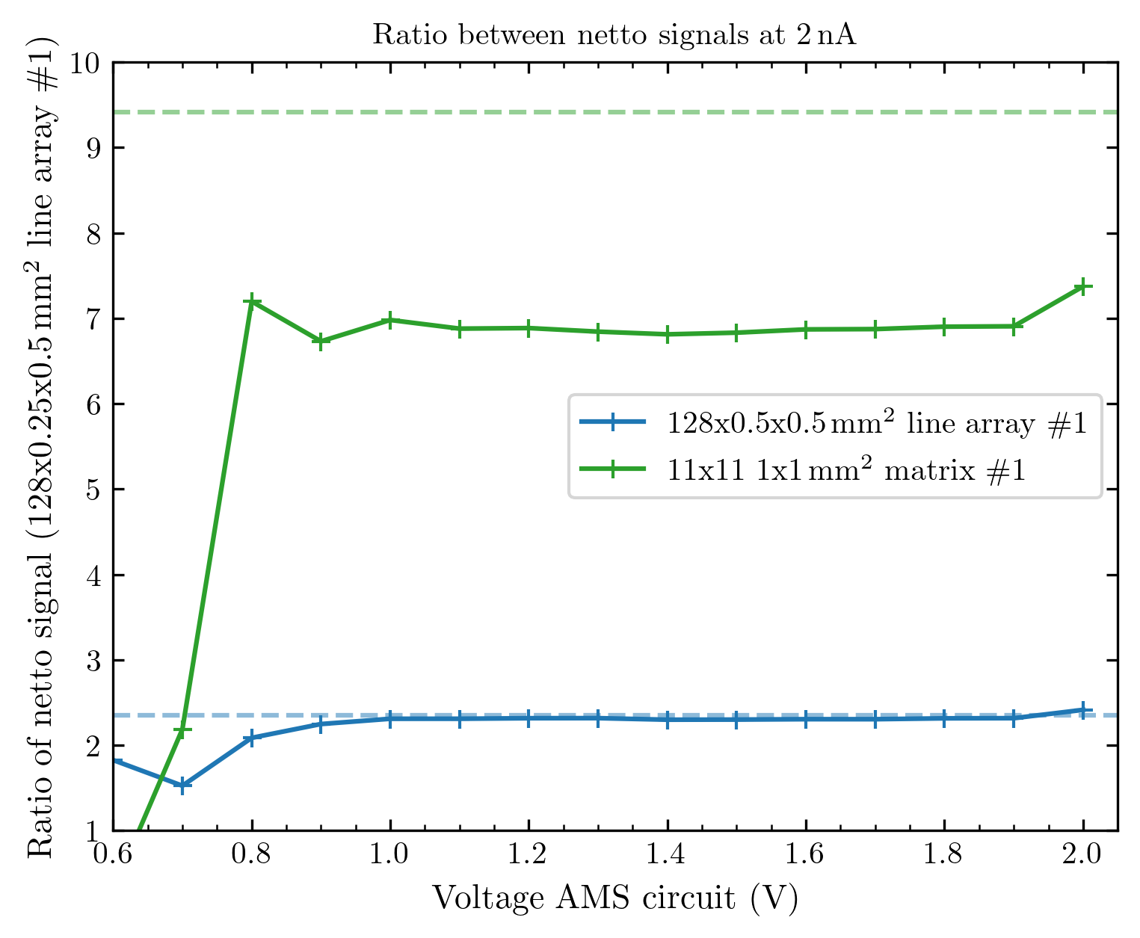
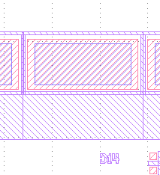
Ratio between the signals
SINGLE DIODE
500µm
10µm
400µm
500µm
400µm
20µm
other measurement day ≠ comparable…
SINGLE DIODE
30µm
10µm
200µm
500µm
250µm
170µm
400µm
200µm

Slide 18
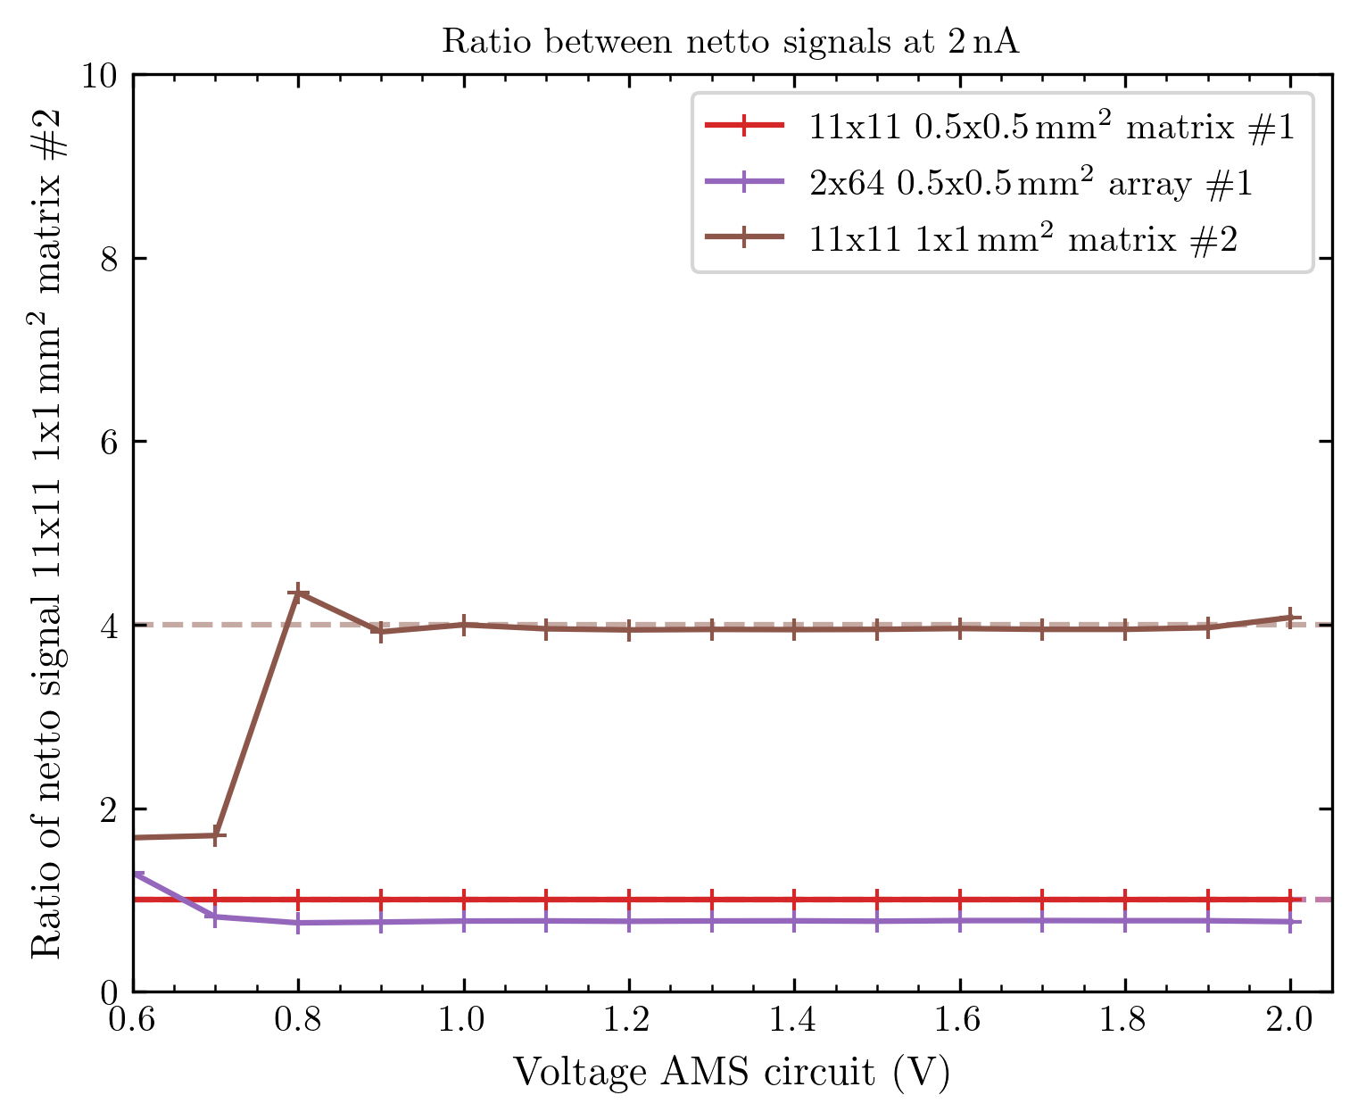
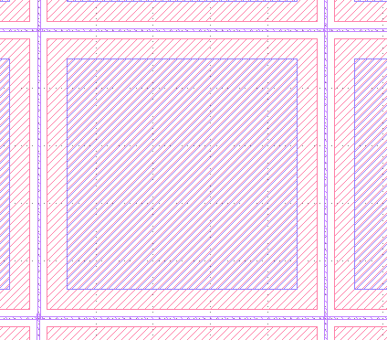
Ratio between the signals
SINGLE DIODE
500µm
10µm
400µm
500µm
400µm
20µm
30µm
10µm
200µm
200µm
70µm
800µm
1mm

Slide 19
What will be analyzed
We measured the linearity voltage-dependent for currents between 0.5 nA – 2.5 nA (5 points)
This is not the biggest range, but it is enough for some quick statements about the linearity of arrays (especially when collecting measurements as a benchmark for new arrays)
Again only diodes with signal will be considered! Signal = netto signal (signal –dark)
I will plot the mean signal of all diodes (black, x) and the signal of each diode (grey, x)
Also plotted: Dark noise (black, v); mean of signal std (blue, ^); std of diodes signal (green, ^)
I also show the inaccuracy of the mean signal = Sqrt[mean of signal std² + std of diodes‘ signal²] (black, ^)
I fit a linear function of type f(x) = a*x to each diode's response and collect their R² value – in the plot I will show the mean of these fits (red, -- line) and the mean of all R² values.
I also fit a function of type f(x) = a*x^{1/2} + (dark noise) to each signal noise, again I will show the mean (red, -- line) and the mean of all R² values.

Slide 20
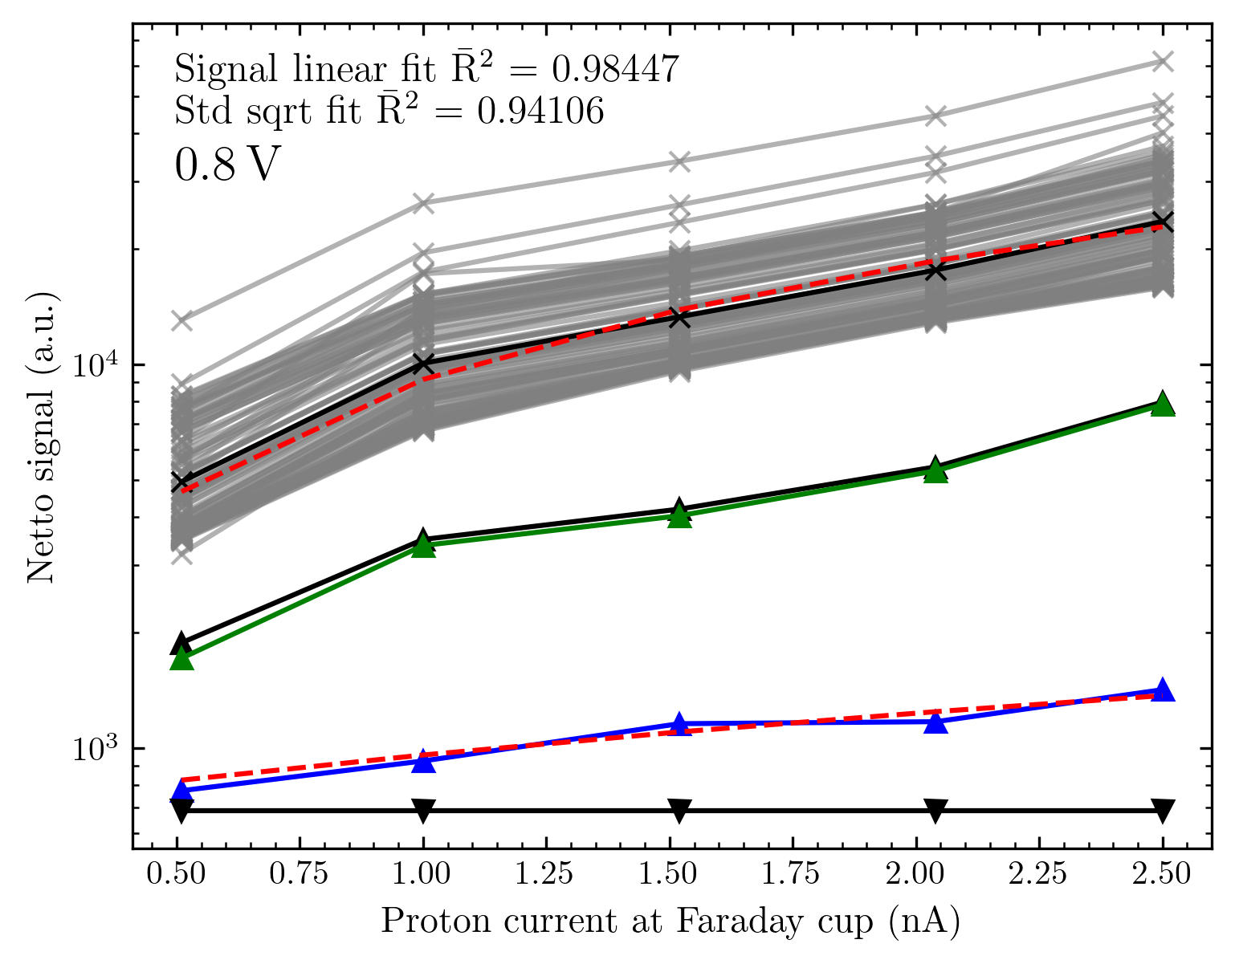
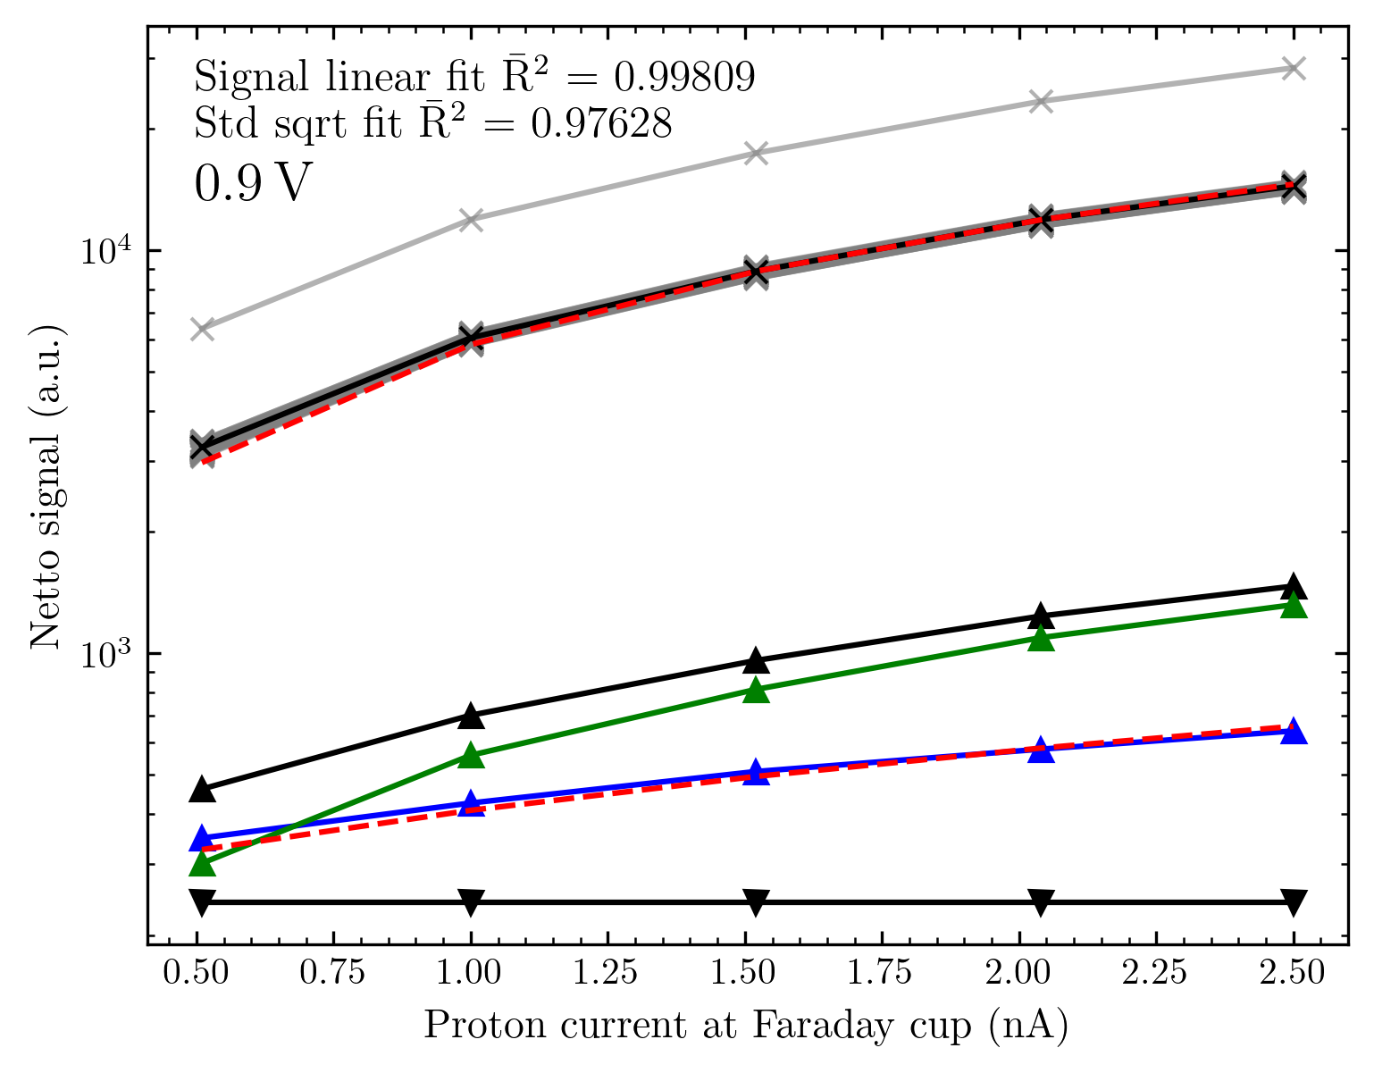
Linearity in dependence of voltage
Small matrix array

Slide 21
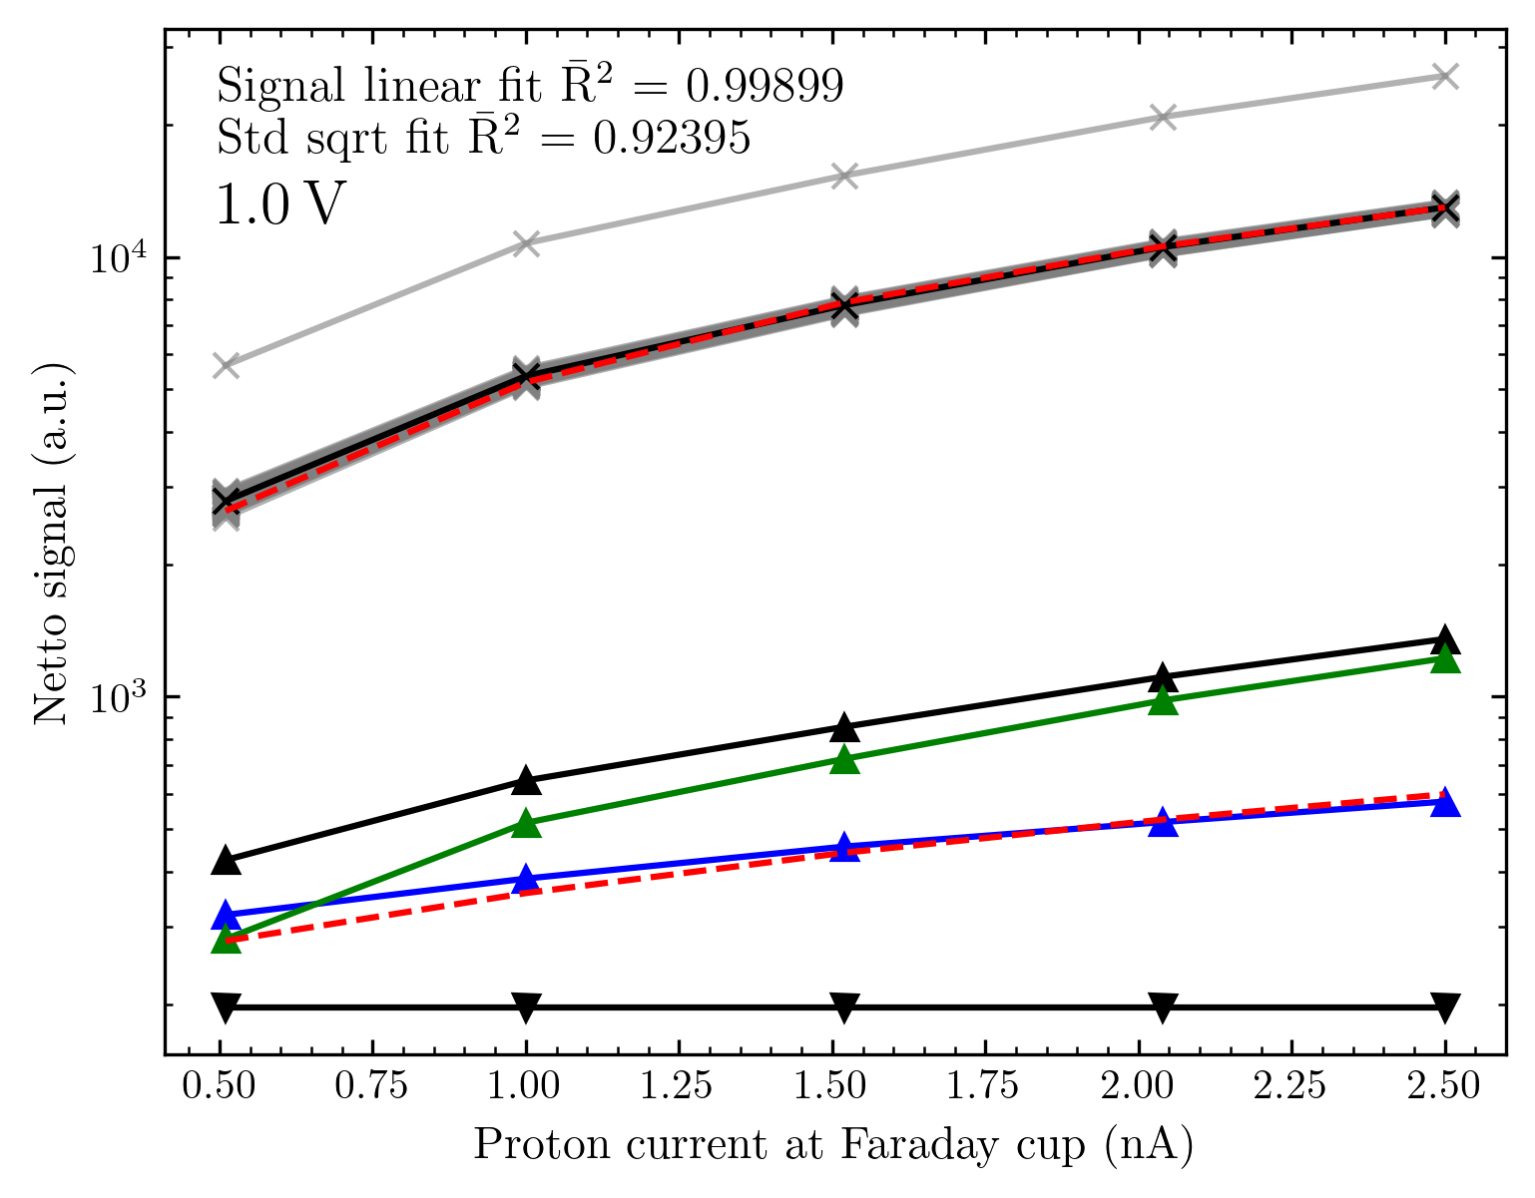

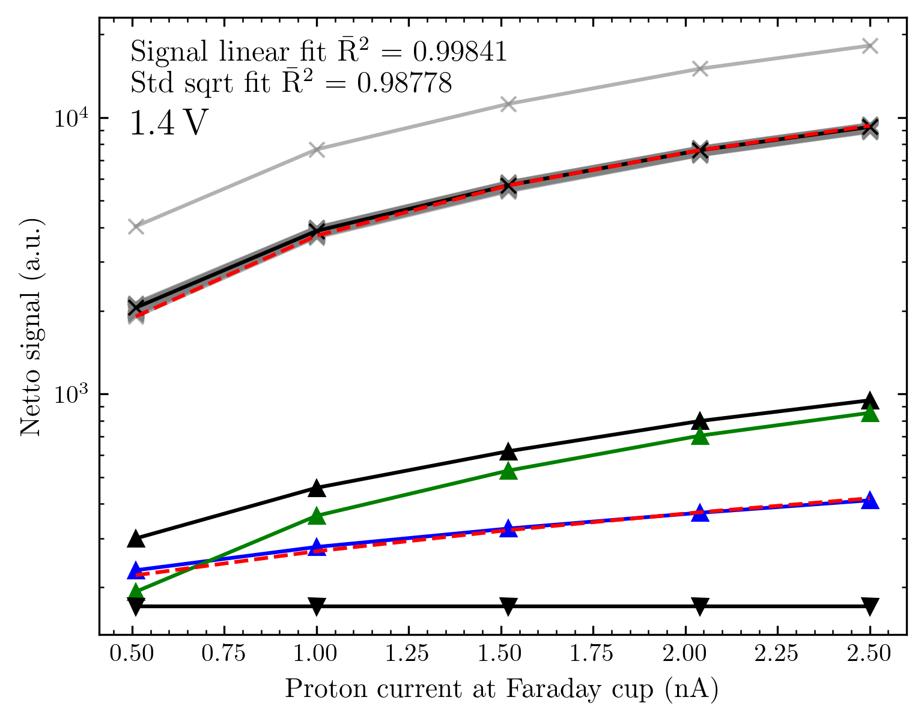
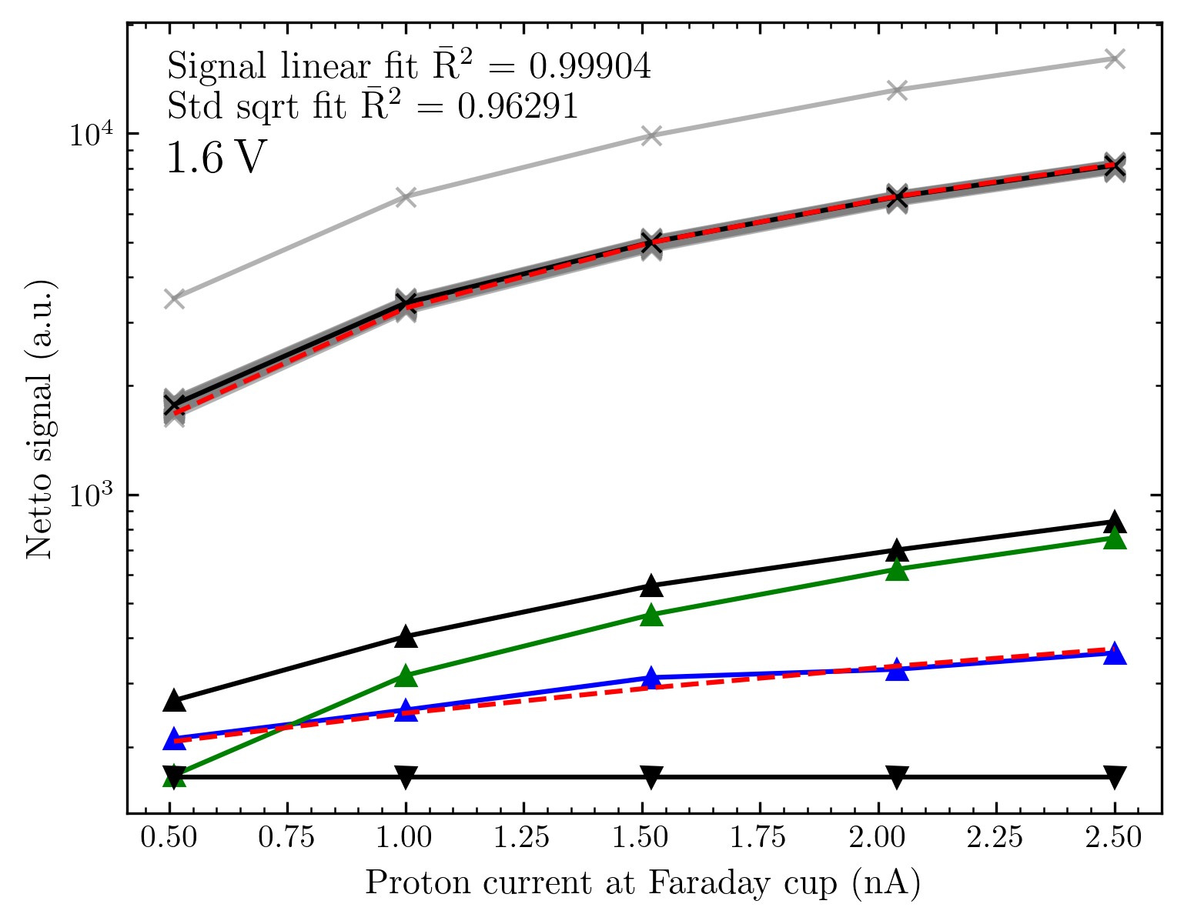
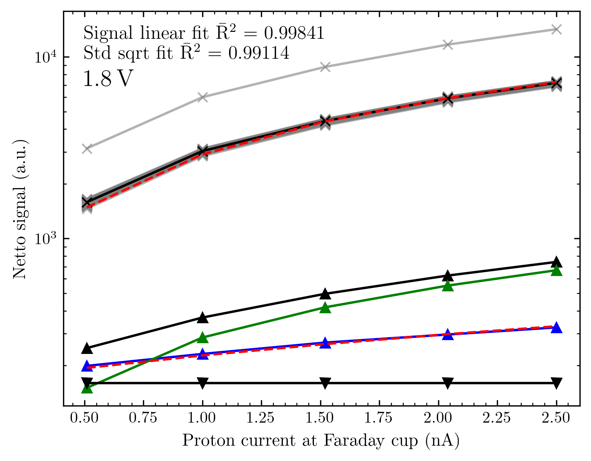
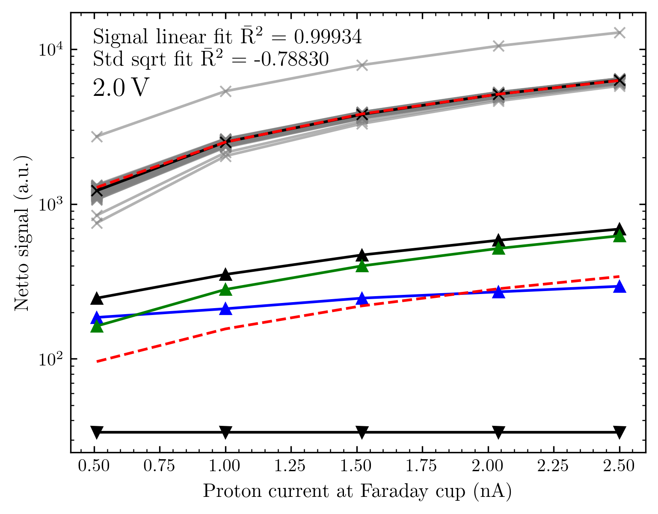
Small matrix array

Slide 22
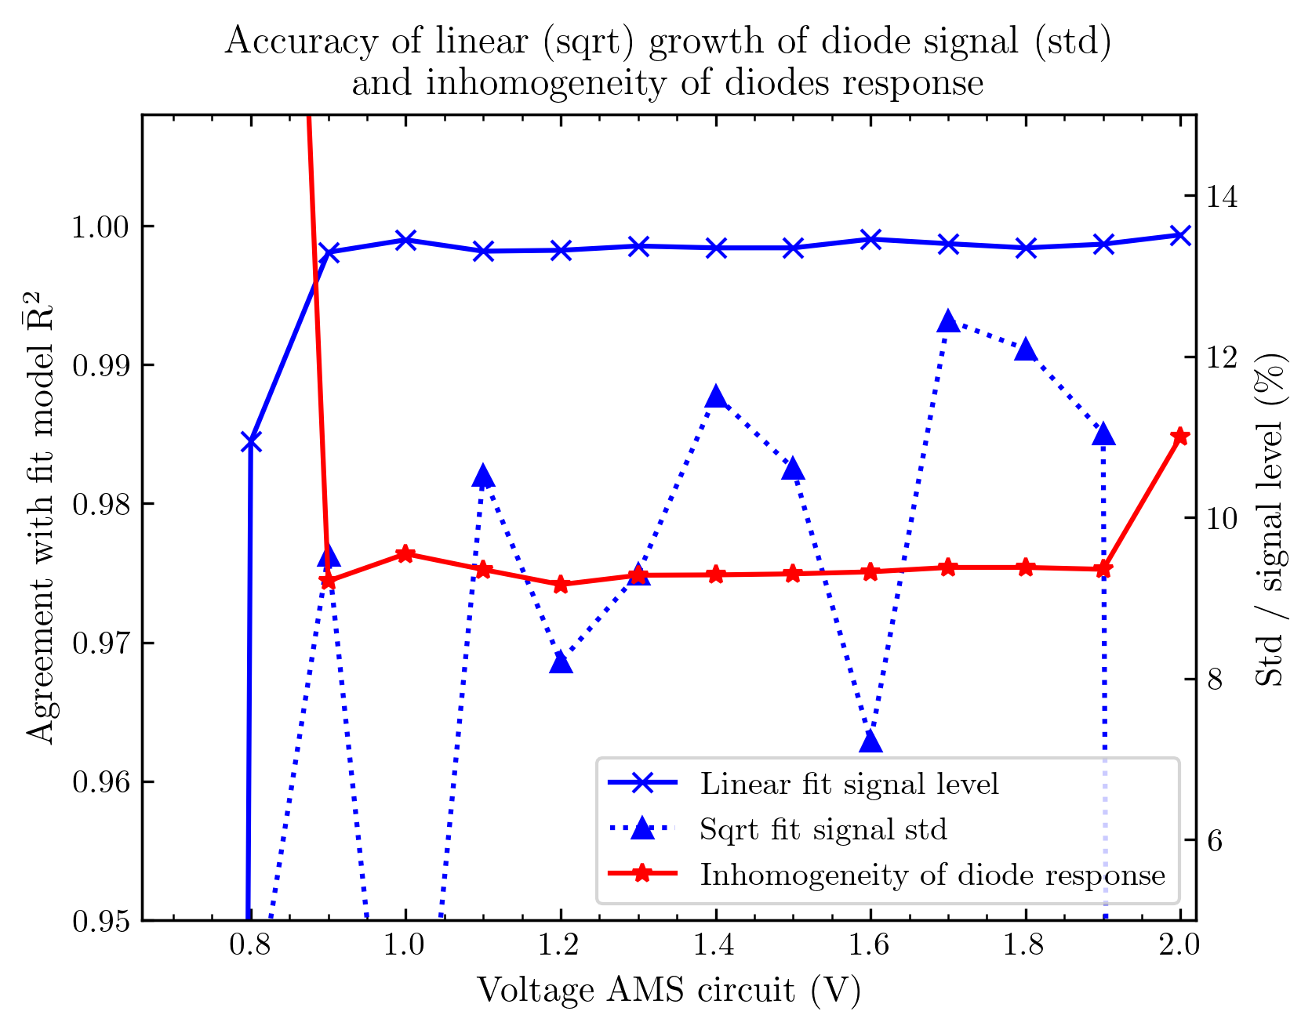
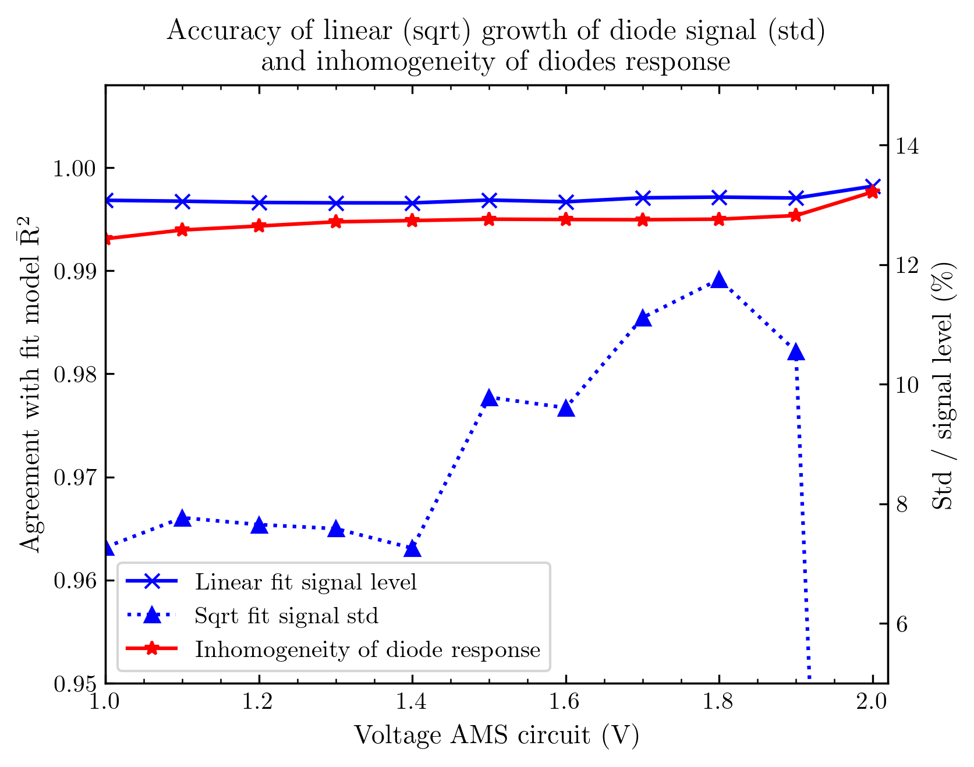
Comparison with voltage
Small matrix array
Big matrix array #1

Slide 23
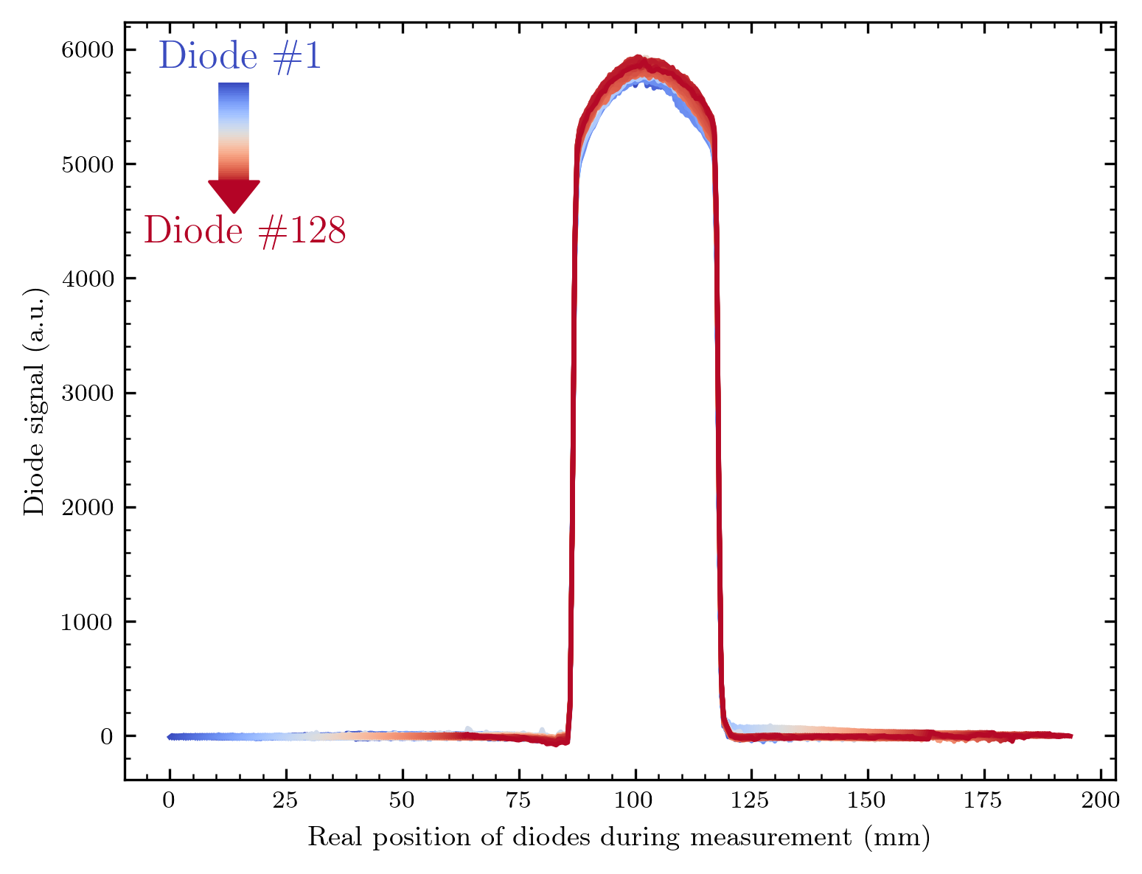
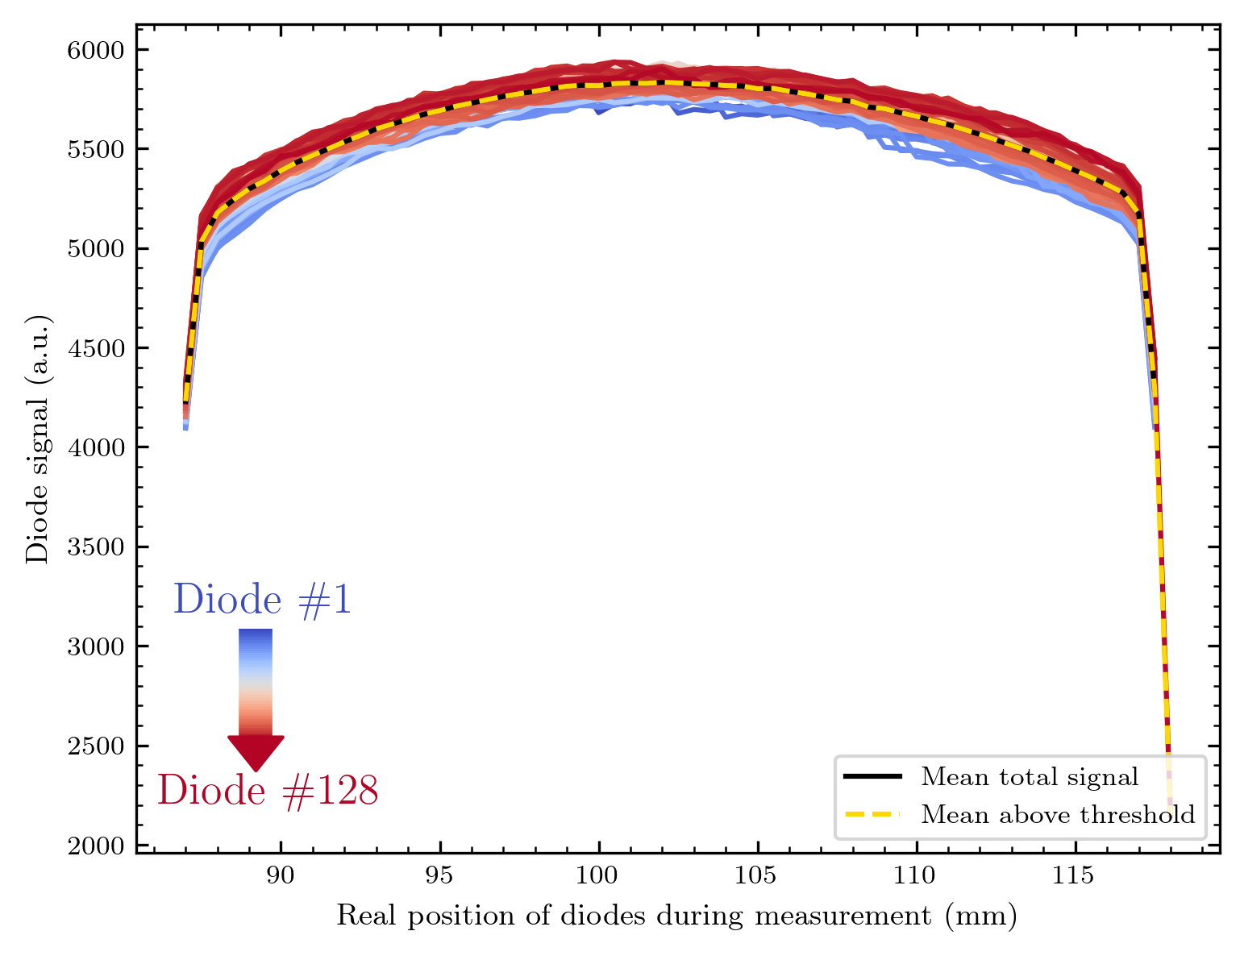
Homogeneity in diode response
Every diode is measured at several (overlapping) positions in the beam
1x128 0.5x0.5 mm² array

Slide 24
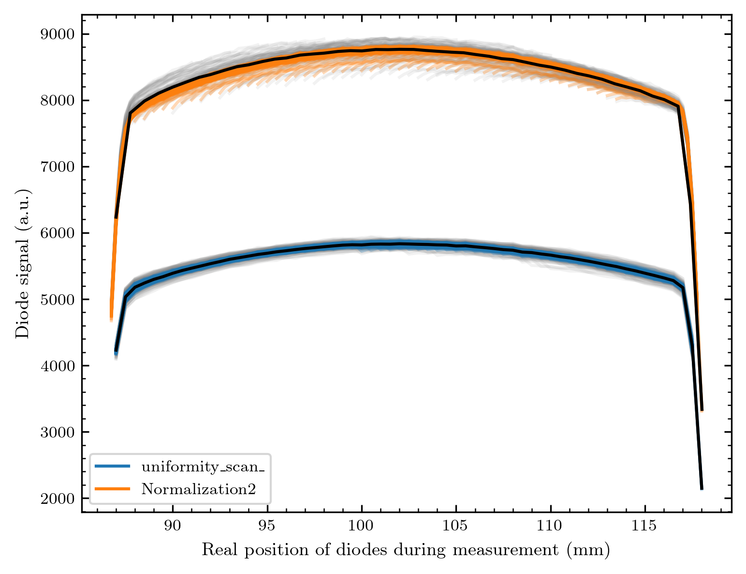
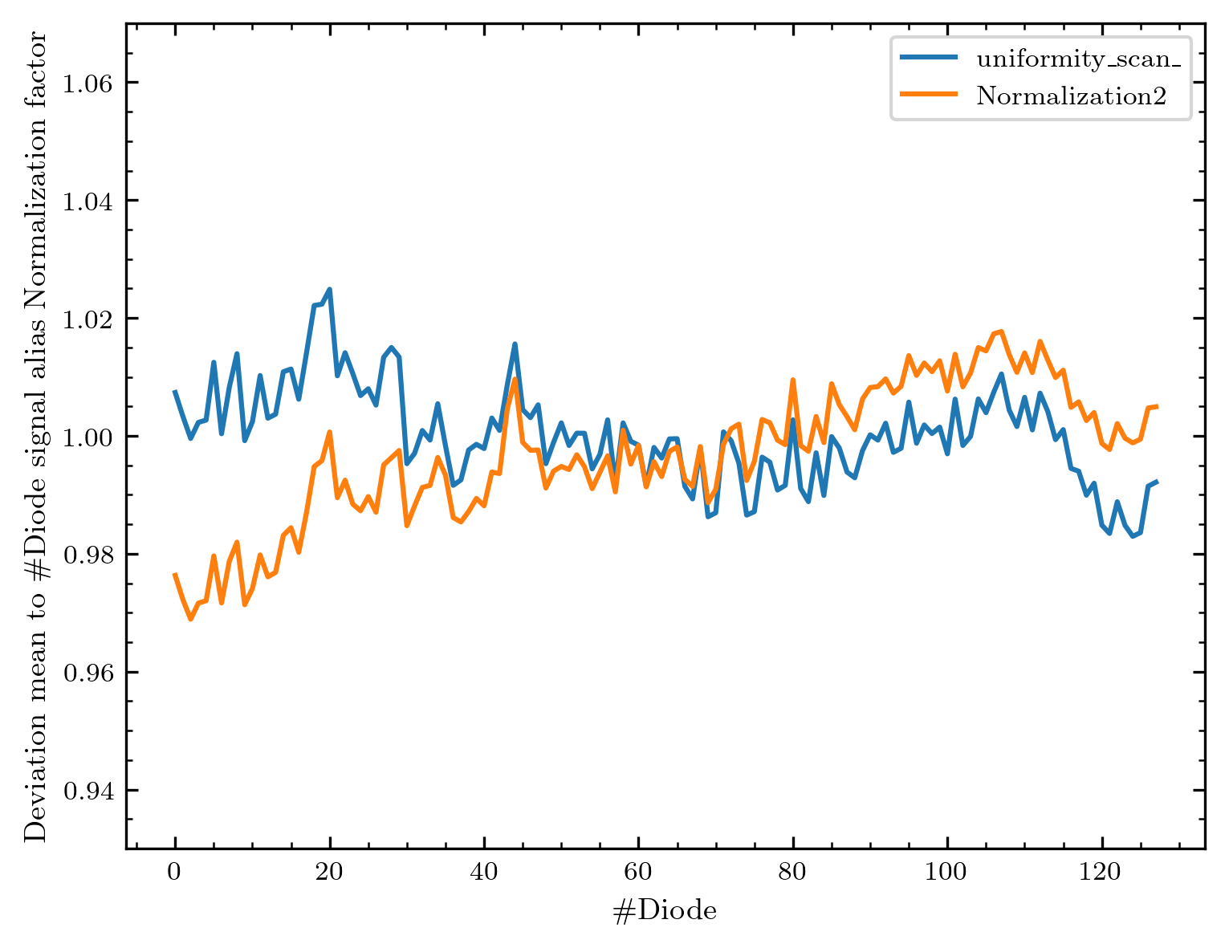
Factor for normalizaton
We are in ≈ 6% diode response homogeneity
1x128 0.5x0.5 mm² array – 2 measurements at different times

Slide 25


Comparison with old array design
Old design had ≈ 120 % deviation, both 128 line arrays are within ≈ 6%
Only one not working diode out of 2 times 128 diodes ≈ efficiency of 99,6 %

Slide 26


Same for 2x64 array / matrix arrays
Not every diode is overlapping at every position!
2x64 0.5x0.5 mm² array

Slide 27



Factor for each line
There seems to be a difference between the two lines?!
After aligning lines to global mean
Note that there is a pattern underneath both curves
The proton current decreased during the measurement
This low-frequency pattern will be filtered in the future!
2x64 0.5x0.5 mm² array

Slide 28




Homogeneity for matrix arrays
Small matrix array
Big matrix array #2

Slide 29


Possible defect of readout circuit
In all of the latest measurements one channel 0 and one channel 2 x the normal signal… they`re neighbours

Slide 30
Part III
Details on image generation
Imaging

Slide 31

How I create the images
Out of translation

Slide 32
How I create the images
Out of translation

Slide 33

How I create the images
Out of translation + diode geometry

Slide 34



Different techniques
I create our images (and in general all plots) with Python’s library Matplotlib:
Pcolourmesh = Different - sized rectangles with colour
Contourf = Values are assigned to coordinate points in between the colour is interpolated
Also possible (but no real gain in my tests): Imshow (equally sized pixels, standard for images)
I create our images (and in general all plots) with Python’s library Matplotlib:
Pcolourmesh = Different - sized rectangles with colour
Contourf = Values are assigned to coordinate points in between the colour is interpolated
Also possible (but no real gain in my tests): Imshow (equally sized pixels, standard for images)

Slide 35



All colourmaps possible!

Slide 36


General info about images I’ll show
Signals are for now shown in units of the AMS circuit output (unclear how to exactly calculate the current out of the AMS output amplitude)
Images are background subtracted and normalized (as shown)
In some cases, I might compensate for single lines not working
I stay with oversampling since I still need to implement a deconvolution into super-resolved pixels

Slide 37
The round aperture / 200 µm diffuser
Real pixel information
1x128 0.5x0.5 mm² array

Slide 38
Sunrise of the proton beam ☺
1x128 0.5x0.5 mm² array

Slide 39



The three available diffusers
40 µm
200 µm
400 µm
2x64 0.5x0.5 mm² array

Slide 40
The misc shape
Real pixel information
1x128 0.5x0.5 mm² array

Slide 41


1x128 0.5x0.5 mm² array
2x64 0.5x0.5 mm² array

Slide 42
The logo
1x128 0.5x0.5 mm² array

Slide 43

Smaller diodes 0.25 mm in scan direction + 0.25 mm steps
0.5 mm diodes + 0.5 mm steps
1x128 0.5x0.25 mm² array
1x128 0.5x0.5 mm² array

Slide 44
Beam imaging without diffuser
1x128 0.5x0.5 mm² array

Slide 45


Smaller diodes 0.25 mm in scan direction + 0.25 mm steps
0.5 mm diodes + 0.5 mm steps
Quite some change of the beam within our measurement day!
Can we get a better time resolution? Live imaging?
Note that we cannot compare the signal here due to the different set voltages!

Slide 46
Part IV
Imaging in time dependence = movies

Slide 47
What was measured?
11x11 1x1 mm² matrix #1 with higher time resolution (≈ 0.7 fps in this case; 1540 images over 36 minutes!)
Video will be x50 increased in speed
The array was fixed during the measurement.
Three phases:
Beam stability (no changes)
Changes with collimation magnets
Wire moving through the beam
(To get a beam profile Cyrcé facility moves wires through the beam line and measures a current. For us this means something shadows the array.)

Slide 48
Three phases:
Beam stability (no changes)
Changes with collimation magnets
Wire moving through the beam
11x11 1x1 mm² matrix array #1

Slide 49
What was measured?
11x11 1x1 mm² matrix #2 with 1 fps
Video will be x30 increased in speed
The array was fixed during the measurement.
What limits faster measurements so far: The readout circuit, or more precisely the software we have to use in the test kit…

Slide 50
Live diffuser in and out
Slit closing
Wire moving
Magnet shift
11x11 1x1 mm² matrix array #2

Slide 51
Square aperture
200 µm diffuser
Current increase from 100 pA to 3.6 nA
(Array is tilted a bit)
11x11 1x1 mm² matrix array #2

Slide 52
Part V
Resolving proton energy
PEEK wedge
Imaging of biological tissue

Slide 53

The Bragg peak (1 map and y translated data)
1x128 0.5x0.5 mm² array

Slide 54
Wedge out of PEEK material

Slide 55

Map of PEEK wedge
2x64 0.5x0.5 mm² array

Slide 56


What if we change the energy of the protons?
We have 20 wheel positions = 20 proton energies!

Slide 57


Energy-dependent wedge measurement
1x128 0.5x0.5 mm² array

Slide 58

Biological tissue
I put this into this category because the mechanism to image tissue is based on our diodes’ energy resolution.
Disclaimer: No animals were harmed exclusively for our measurements!
Measurement with 2x64 array (1 no signal diode replaced, oversampling)

Slide 59



Slide 60
Part VI
Comparison with Gafchromic Images

Slide 61



Gafchromic images

Slide 62


Method to obtain a comparable response

Slide 63

Some qualitative comparisons
2x64 0.5x0.5 mm² array

Slide 64


Some qualitative comparisons
2x64 0.5x0.5 mm² array

Slide 65


High exposure?
2x64 0.5x0.5 mm² array

Slide 66


Energy resolution?
2x64 0.5x0.5 mm² array

Slide 67


And finally one quantitative comparison
1x128 0.5x0.5 mm² array

Slide 68




H
B
G
D
1x128 0.5x0.5 mm² array

Slide 69

Norm all to 1 and align x-axes to get a quantitative comparison!
Data from Gafchromic extracted with online tool – points aligned by hand
(without investing several hours this at least gives a nice idea of the data curve)
Looks excellent, and it seems that our normed response can be compared to the response of the gafchromic!
H
B
G
D
1x128 0.5x0.5 mm² array

Slide 70
Part VII
Outlook:
Results I haven‘t shown Future plans

Slide 71
Not shown / results not ready yet
Energy dependent imaging
Voltage dependent imaging
Super-resolution: Can we improve our images by oversampling?
More movies / images
Gafchromic difference maps
How many samples do we need to get good measurements?
And even more different things

Slide 72
Outlook
Using a simulation software for validation (GEANT4 interfaced by GATE)
Deposited energy = signal?
Projection on to other facilities (e.g. more energy)
Contributions to energy deposition
Possible damage channels
Long-term irradiation damage studies
Measuring at other facilities
Detecting carbon ions?
Important: Getting the new readout circuits!

